Slide 1
Designing Rhythm Games for Touchscreen Devices
Project Progress Report
Members: Philip H. Peng
Advisor: Dr. Stephen H. Lane
CIS 401, Fall 2011, University of Pennsylvania

Slide 2
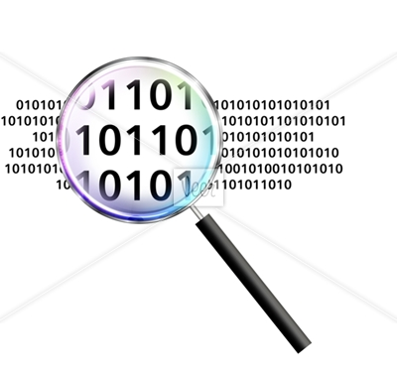
Presentation Overview
Summary
Project Proposal
Related Work
Project Outline
Progress
Demo
Results
Progress Report, CIS 400, Fall 2011
Philip Peng, 2011/12/07

Slide 3
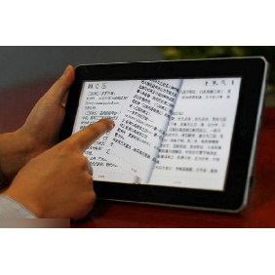
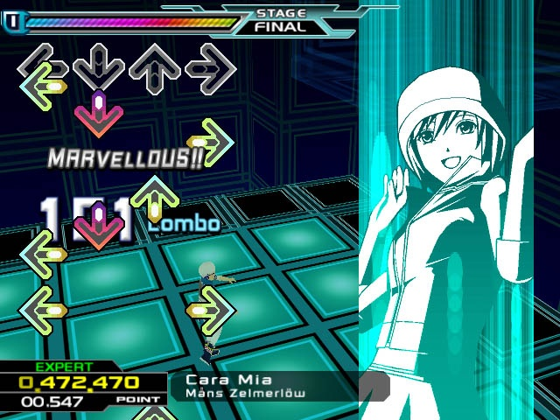
Summary
Rhythm game: time critical, response-based
Touchscreen: new input method
Rhythm game for touchscreen: how to design the interface for highly reactive gameplay?
Progress Report, CIS 400, Fall 2011
Philip Peng, 2011/12/07

Slide 4
Project Proposal
Goal:
Design, prototype, and evaluate different rhythm games interfaces for touchscreen devices.
Approach:
Create a rhythm game prototype for Android tablets that demos various game interfaces and collects usage data to evaluate their effectiveness.
Progress Report, CIS 400, Fall 2011
Philip Peng, 2011/12/07

Slide 5
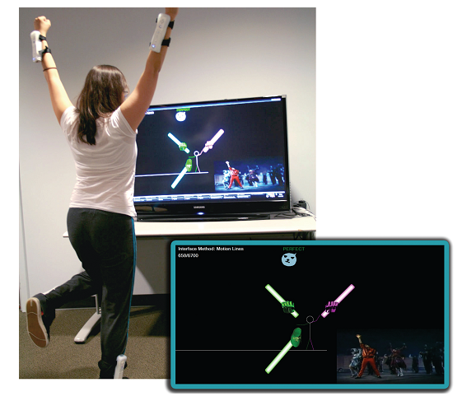
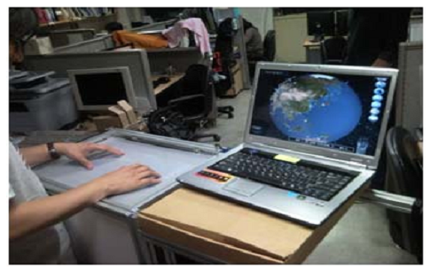
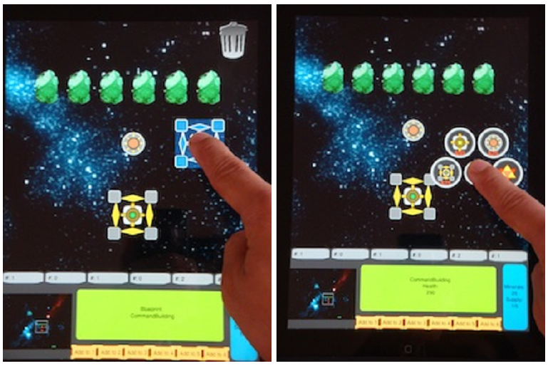
Related Work
Wiimote + Dance Game
“Understanding Visual Interfaces for the Next Generation of Dance-Based Rhythm Video Games” – University of Central Florida, Orlando, FL
External Multi-touch Panel + Turn-Based Strategy Game
“A Study on Multi-Touch Interface for Game” – Chung-Ang University, Seoul, Korea
Overlayed Multi-touch Screen + Real-Time Strategy Game
“One-handed Interface for Multi-Touch Enabled Real-Time Strategy Games” – University of California, Santa Cruz, CA
Progress Report, CIS 400, Fall 2011
Philip Peng, 2011/12/07

Slide 6
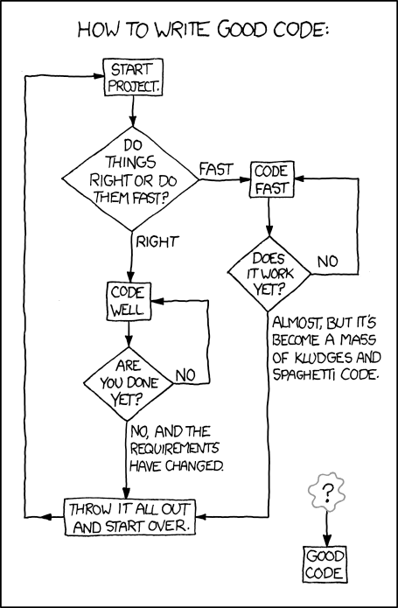
Project Outline
Design – Draft
Investigate existing interface designs
Draft designs and evaluation metrics
2) Prototype – Code
Implement these designs via Android
Use common backbone to reduce non-relevant factors
3) Evaluation - Data
Release to public with data analytics plugin
Analyze collected data
Progress Report, CIS 400, Fall 2011
Philip Peng, 2011/12/07

Slide 7
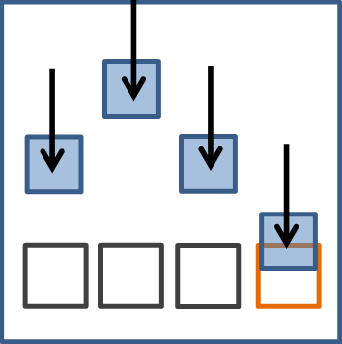
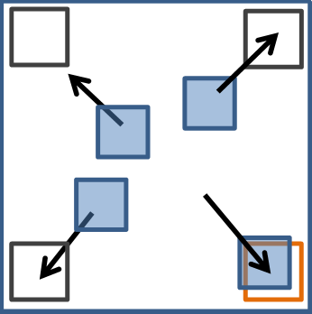
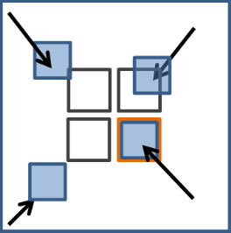
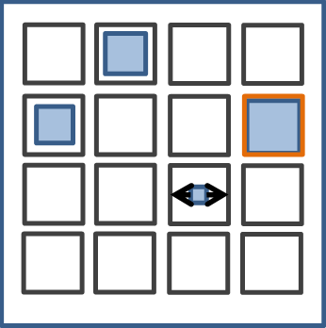
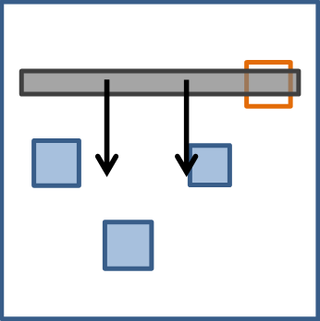
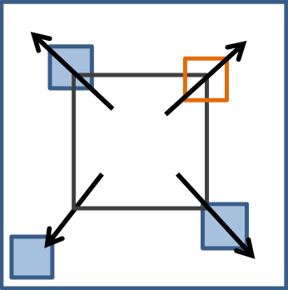
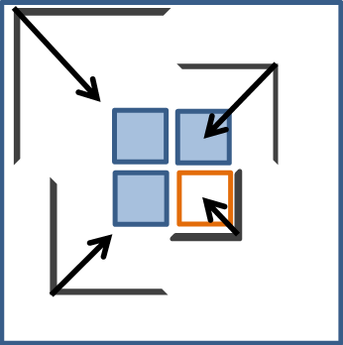
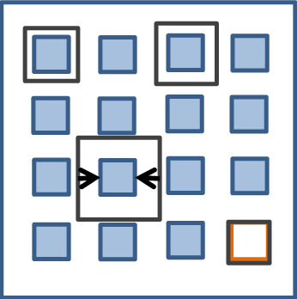
Progress
Design – Designs
Interface designs finalized:
Progress Report, CIS 400, Fall 2011
Philip Peng, 2011/12/07

Slide 8
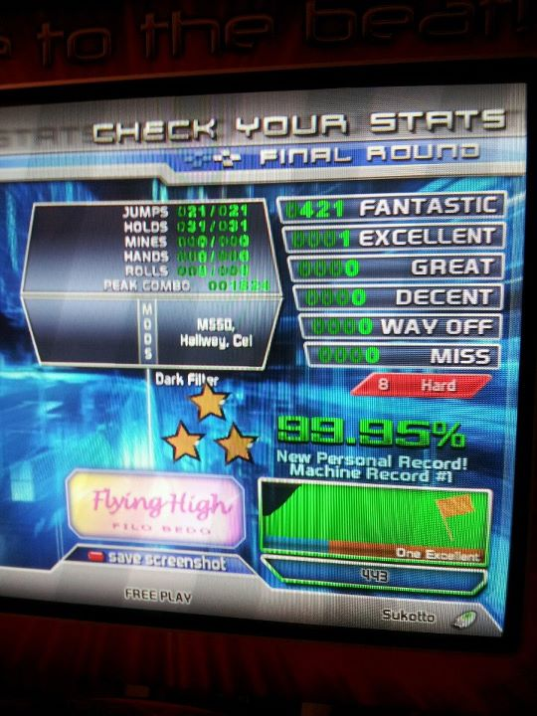
Progress
Design – Metrics
Test song: smooooch (Beatmania IIDX)
High note frequency and 177 BPM
Strong audible baseline (good for rhythm)
Auto-generated stepfile (Dancing Monkeys)
Metrics per design:
Total accuracy percent (data)
Missed note count (data)
Ranked enjoyability relative to other designs (feedback)
Full timing chart will also be collected for overall trend analysis (if there are any)
Progress Report, CIS 400, Fall 2011
Philip Peng, 2011/12/07

Slide 9
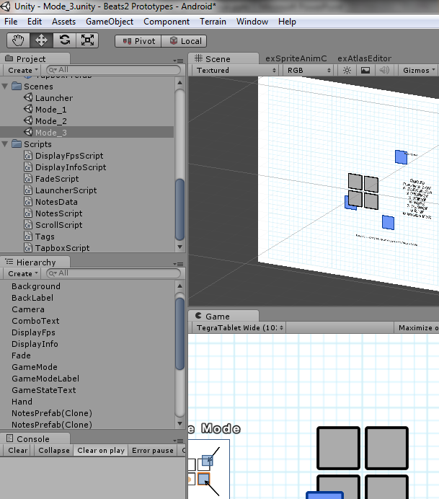
Progress
Prototype – Unity
Biggest challenge of project
Game designer vs. Programmer
Unity = GameObject driven workflow
New to C#
Game Engine Experimentation
Android + iOS license
Othello2D vs ex2D
TouchGestures overcomplicated
MonoDevelop minimalistic
Progress Report, CIS 400, Fall 2011
Philip Peng, 2011/12/07

Slide 10
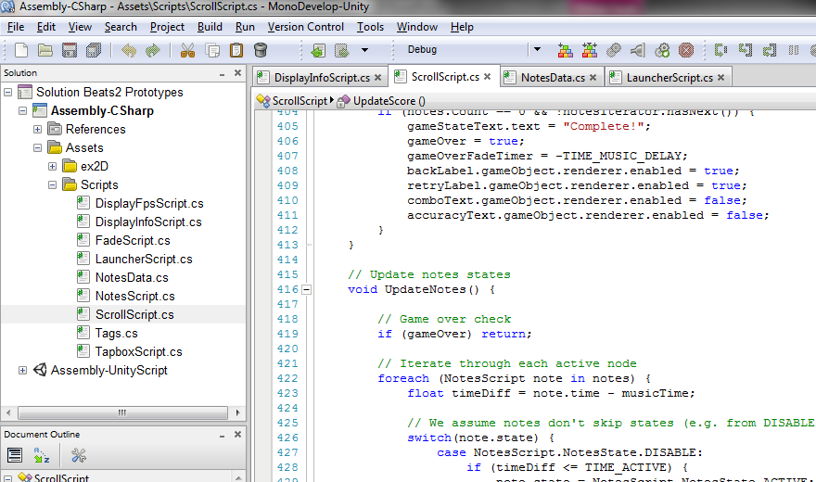
Progress
Prototype – Coding
Flexible game engine
Timer, audio-synchronized
Dynamic object generator, memory efficient
Score tracking, based on timing accuracy
Runs on Android tablet and Windows
Adding new modes (interfaces) easy
Progress Report, CIS 400, Fall 2011
Philip Peng, 2011/12/07

Slide 11
Progress
Evaluation – Setup
Tweaking stage
Change object placements based on feedback
Tweak timing parameters
Improve graphics?
Google Analytics vs own server
Analytics: generate graphs but limited info collection
Server: custom information but have to set up
Mass release on Android Market
Use Beats’ update notifier to advertise (100k+ active users)
Progress Report, CIS 400, Fall 2011
Philip Peng, 2011/12/07

Slide 12
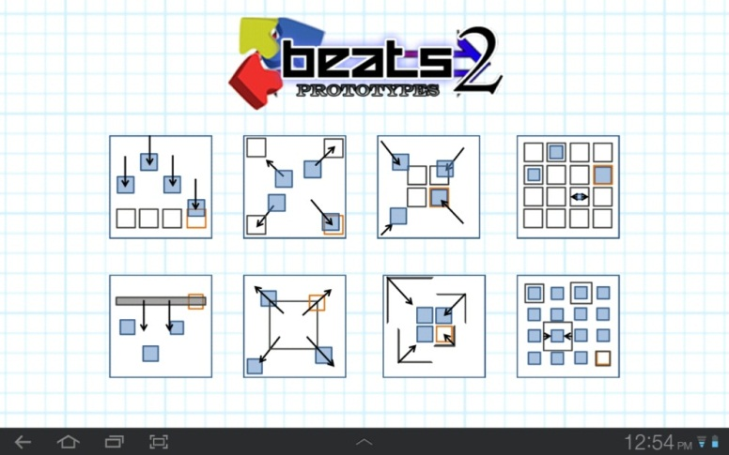
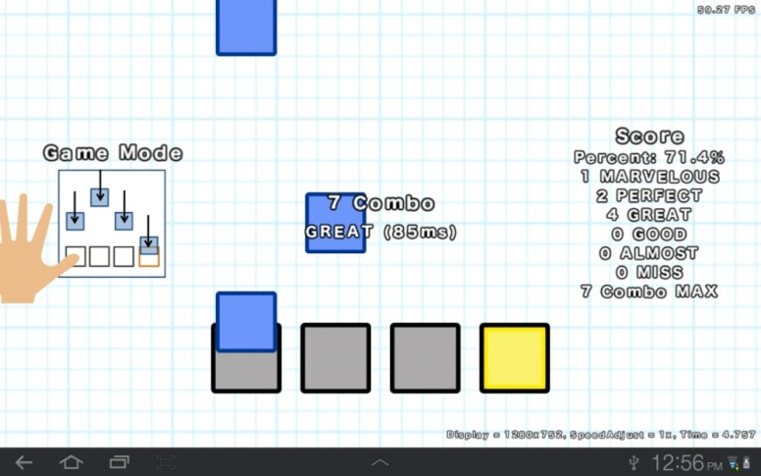
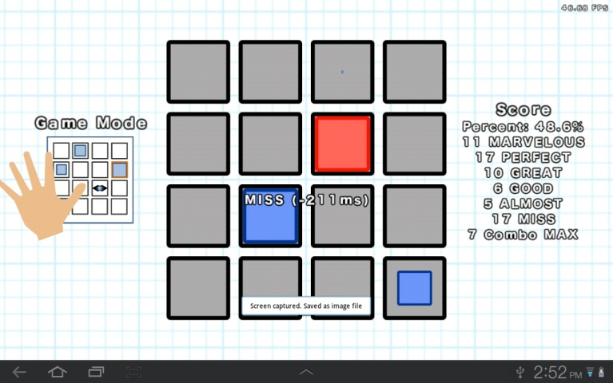
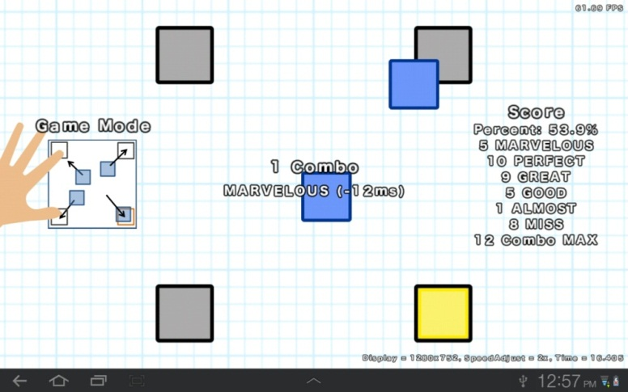
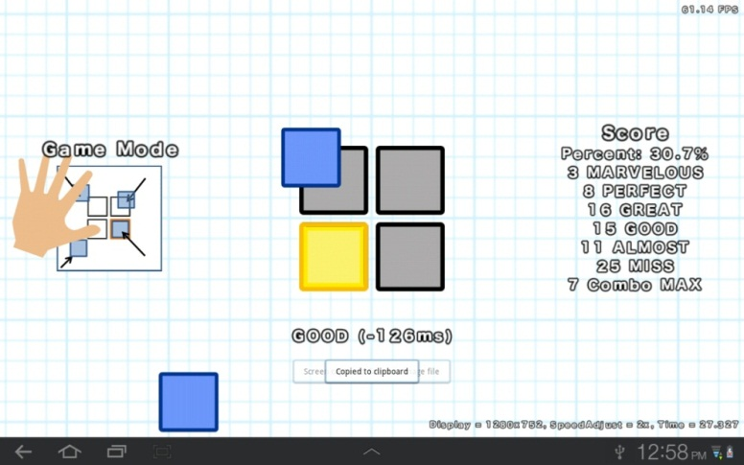
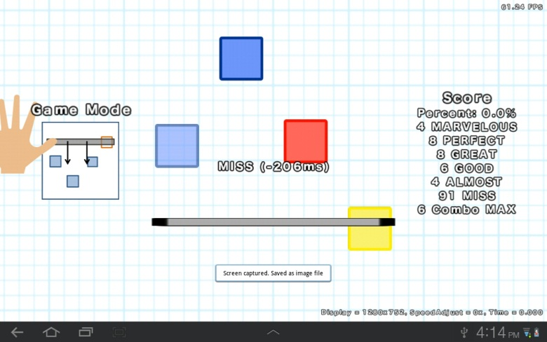
Demo
Progress Report, CIS 400, Fall 2011
Philip Peng, 2011/12/07

Slide 13
Results
Programming:
Unity hard to learn but very flexible and worthwhile - write once, deploy everywhere
ex2D very useful but very buggy and crashes
Framerate very good (consistent 60fps) but timing window a bit too big (~15ns update rate)
Code currently in one main script – need to learn more about Unity coding conventions (static global object?)
Progress Report, CIS 400, Fall 2011
Philip Peng, 2011/12/07

Slide 14
Results
Informal surveys:
Testers used to DDR style scrolling
Speed needs to be tweaked (some tester just had slow visual processing times)
Tapbox placement definitely a factor (proximity to each other, spread of focus)
Enjoyment factor independent from performance
May try two songs to eliminate song familiarity from evaluation
Progress Report, CIS 400, Fall 2011
Philip Peng, 2011/12/07

Slide 15
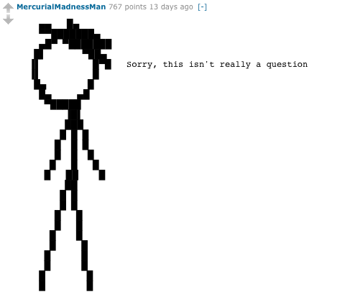
Questions?
Progress Report, CIS 400, Fall 2011
Philip Peng, 2011/12/07

