Slide 1
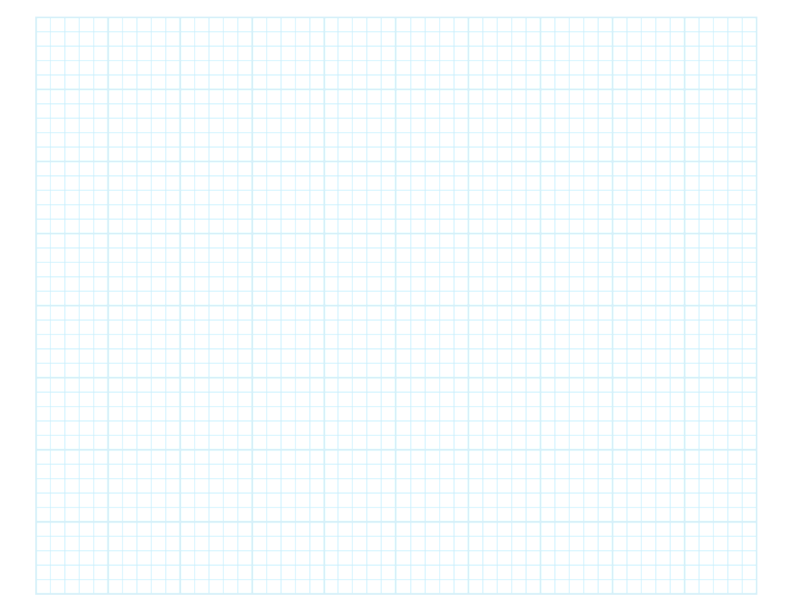

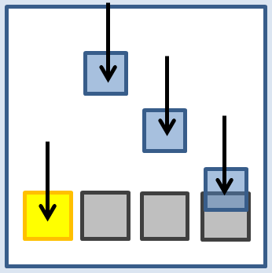
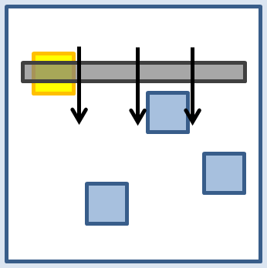




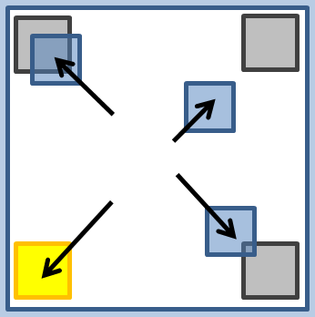
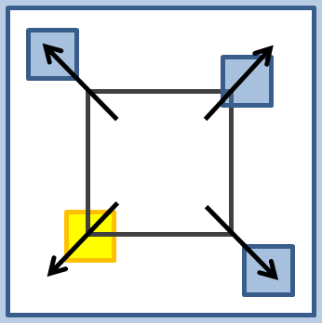

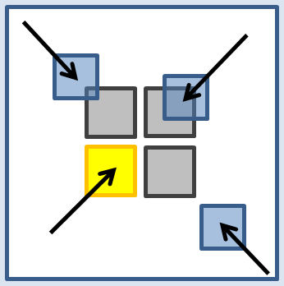
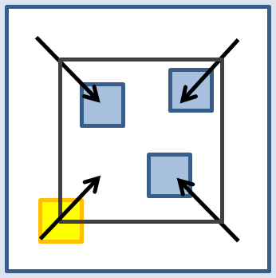
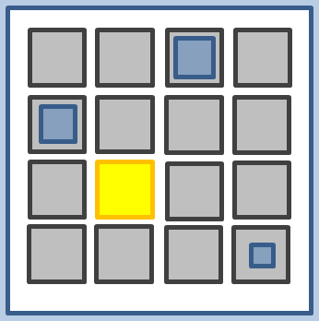
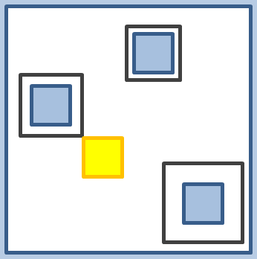

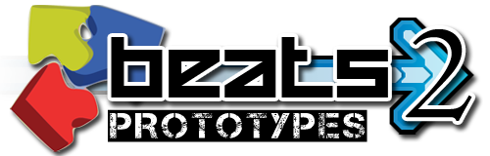
Designing Rhythm Games for Touchscreen Devices
By Philip Peng, Faculty Advisor: Stephen H. Lane
Design 1: Fall
http://beatsportable.com
Feedback:
Abstract:
This project focuses on designing and comparing different touchscreen user interfaces for rhythm games. This is accomplished through the development of a rhythm game for Android tablets.
Data Results:
The game, “Beats2 Prototypes”, was published on Google Play. This poster presents the collected data and feedback. Note that the exact same rhythm game patterns and timing windows are used in all 8 designs ("Game Modes").
Feedback: Qualitative 1-5 star scale ratings.
Challenge: Difficulty of the gameplay, affects timing reactivity /enjoyability
Intuitive: Ease of use and learning of interface. Intuitive = more desirable
Fun: Game enjoyability with this design. More fun = better game
Unique: Novelty/uniqueness of design relative to other published games
Accuracy: Quantitatively data tracking.
Breakdown of average timing accuracies, also reflected in the percent scores. A higher percent score quantitatively measures how well the interface design aided in improving the user’s sense of rhythm.
Analysis:
Design #1 was the most commonly played mode, with the highest mode select frequency (18%). Despite this, it was not always necessarily the most effective.
Qualitatively, Design #3 and #5 had very similar accuracy charts to #1 (~80% "GREAT" or better) wheras #2 proved to be significantly better in improving timing accuracy (91%). The overall percent score averages reflected that trend.
Qualitatively, Design #4 was the best rated, receiving 4 stars in almost all categories, followed by Design #5. Designs #6 and #7 (both changing hitbox sizes) were perceived as poor designs, received the lowest ratings in "Intuitive" (2.6/2.8) and highest in "Challenge" (4.8/4.6). Design #1 and #8 received the lowest "Unique" ratings (2.8/2.8), being similar to popular rhythm games DDR and Osu!
Overall:
Recommended designs to implement in future rhythm games for touchscreen devices would be Designs #2, #3, #4, and #5. Designs #1 and #8 are fine but not unique, while #6 and #7 are poor designs for touchscreen devices.
Design 5: Slide
Feedback:
Category | Ratings | Avg
Challenge |  | 3.6
Intuitive |  | 4.0
Fun |  | 3.6
Unique |  | 2.8
Overall |  | 3.7
Category | Ratings | Avg
Challenge |  | 4.3
Intuitive |  | 3.1
Fun |  | 3.9
Unique |  | 4.3
Overall |  | 3.7
Description: Moving notes fall toward fixed hitboxes at bottom edge
Rhythm Games: Dance Dance Revolution, Guitar Hero, Beatmania IIDX
Description: Moving hitbox fall toward fixed notes from top to bottom
Rhythm Games: DJMax Technika
Design 2: Spread
Feedback:
Design 6: Expand
Feedback:
Category | Ratings | Avg
Challenge |  | 3.7
Intuitive |  | 3.8
Fun |  | 4.0
Unique |  | 3.7
Overall |  | 4.1
Category | Ratings | Avg
Challenge |  | 4.8
Intuitive |  | 2.6
Fun |  | 3.2
Unique |  | 4.7
Overall |  | 3.4
Description: Moving notes slide toward fixed hitboxes at the corners
Rhythm Games: none
Description: Expanding hitbox grows toward fixed notes from centre
Rhythm Games: none
Design 3: Focus
Feedback:
Design 7: Collapse
Feedback:
Category | Ratings | Avg
Challenge |  | 3.7
Intuitive |  | 3.9
Fun |  | 3.5
Unique |  | 3.8
Overall |  | 3.4
Category | Ratings | Avg
Challenge |  | 4.6
Intuitive |  | 2.8
Fun |  | 3.2
Unique |  | 4.5
Overall |  | 3.4
Description: Moving notes slide toward fixed hitboxes at the centre
Rhythm Games: Gitaroo Man Lives!, Hatsune Miku: Project DIVA
Description: Collapsing hitbox shrink toward fixed notes from corner
Rhythm Games: none
Design 4: Grid
Feedback:
Design 8: Appears
Feedback:
Category | Ratings | Avg
Challenge |  | 4.4
Intuitive |  | 3.8
Fun |  | 4.1
Unique |  | 4.0
Overall |  | 4.0
Category | Ratings | Avg
Challenge |  | 3.6
Intuitive |  | 4.0
Fun |  | 3.6
Unique |  | 2.8
Overall |  | 3.7
Description: Expanding notes grow at fixed hitboxes a grid points
Rhythm Games: jubeats
Description: Collapsing hitboxes around fixed notes appearing at grid points
Rhythm Games: Osu! Tatakae! Ouendan!
Senior Project Poster Day 2012 – Department of Computer and Information Science

