Slide 1
Designing Rhythm Game Interfaces for
Touchscreen Devices
Project Progress Report
Members: Philip H. Peng
Advisor: Dr. Stephen H. Lane
CIS 400, Fall 2011, University of Pennsylvania

Slide 2
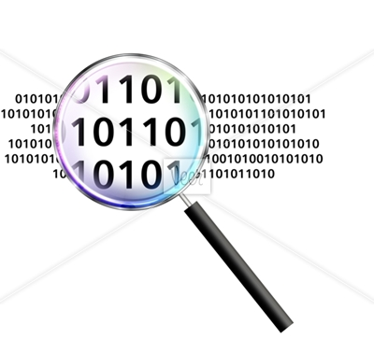
Presentation Overview
Introduction
Project Proposal
Related Work
Project Outline
Design – Interfaces
Prototype – Application Layout
Prototype – Demo Video (WIP)
Evaluation
Stretch Goals
Remaining Work
Progress Report, CIS 400, Fall 2011
Philip Peng, 2011/12/07

Slide 3
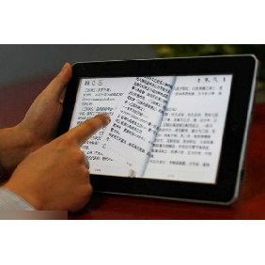
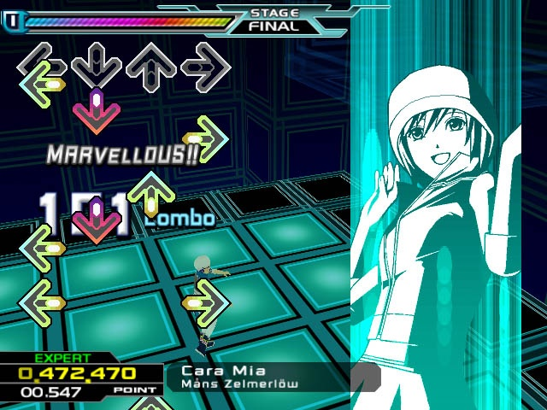
Introduction
Rhythm Games: genre of music games, notes and hitboxes, mix of puzzle/action
Touchscreen Devices: devices that use touch for default input
Progress Report, CIS 400, Fall 2011
Philip Peng, 2011/12/07

Slide 4
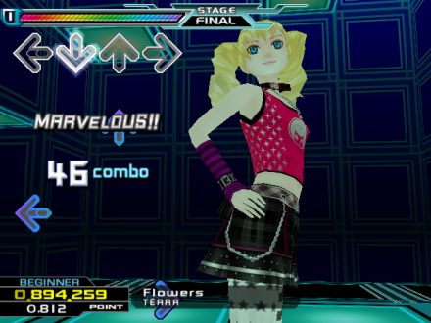
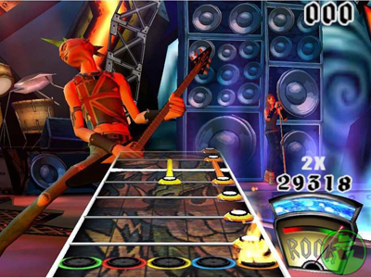
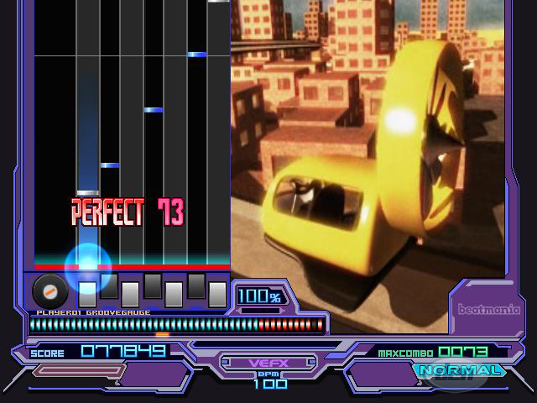
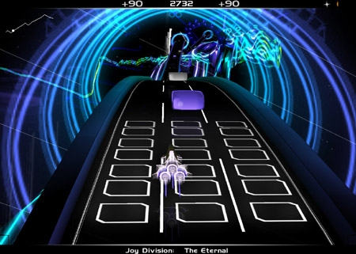
Rhythm Game Examples
Dance Dance Revolution
Guitar Hero
Progress Report, CIS 400, Fall 2011
Philip Peng, 2011/12/07
Beatmania IIDX
AudioSurf

Slide 5
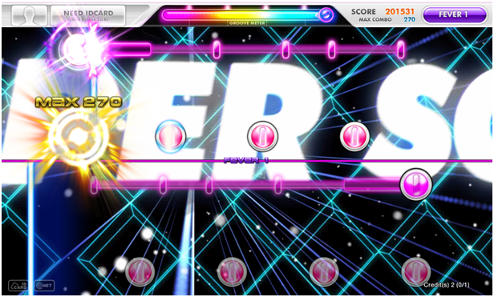
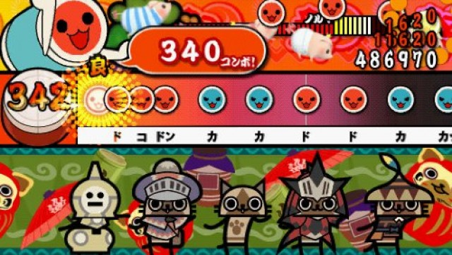
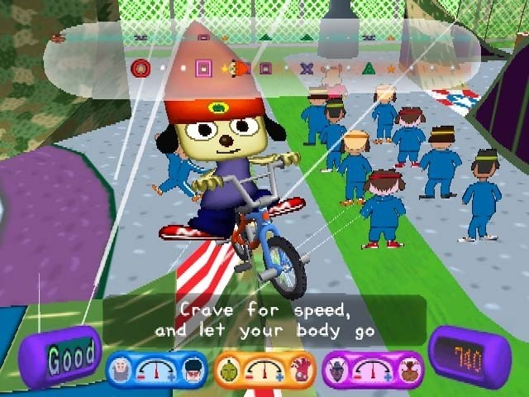
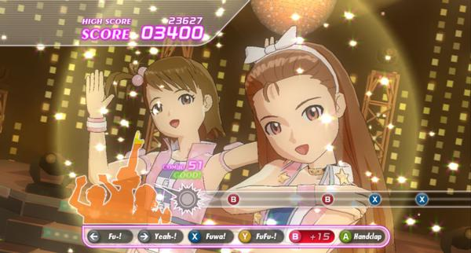
More Rhythm Game Examples
DJMax Technika
Taiko no Tatsujin
Progress Report, CIS 400, Fall 2011
Philip Peng, 2011/12/07
PaRappa the Rapper
THE iDOLM@STER

Slide 6
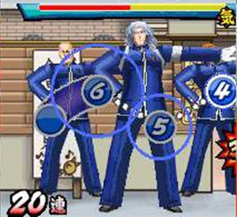
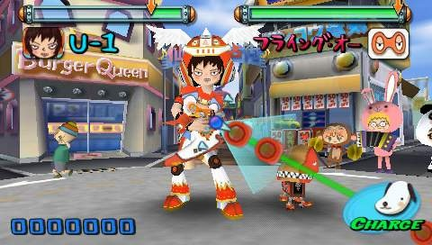
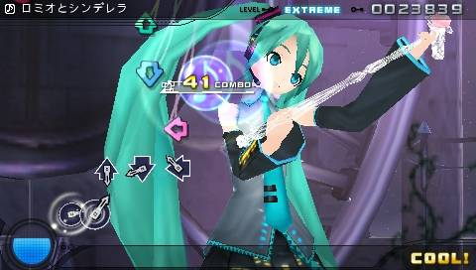
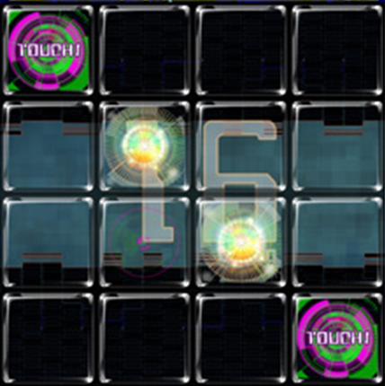
Even More Examples!
Osu! Tatakae! Ouendan!
Gitaroo Man Lives!
Progress Report, CIS 400, Fall 2011
Philip Peng, 2011/12/07
Hatsune Miku: Project DIVA
Jubeat Plus

Slide 7
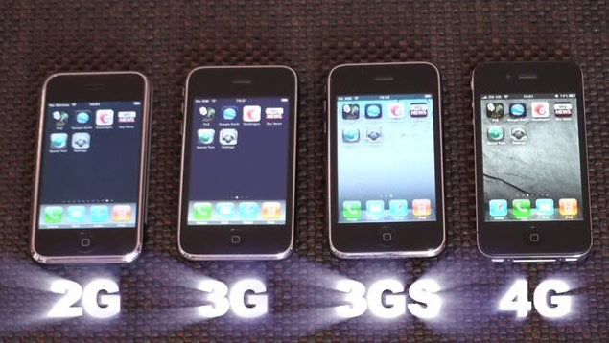
Question
Aren’t they all the same?
Progress Report, CIS 400, Fall 2011
Philip Peng, 2011/12/07
Looks and usage may differ but ultimately all do the same thing

Slide 8
Multi-Column Interface
Dance Dance Revolution
Guitar Hero
Progress Report, CIS 400, Fall 2011
Philip Peng, 2011/12/07
Beatmania IIDX
AudioSurf

Slide 9
Multi-Column Interface
Dance Dance Revolution
Guitar Hero
Progress Report, CIS 400, Fall 2011
Philip Peng, 2011/12/07
Beatmania IIDX
AudioSurf

Slide 10
Moving/Point Focus Interface
DJMax Technika
Taiko no Tatsujin
Progress Report, CIS 400, Fall 2011
Philip Peng, 2011/12/07
PaRappa the Rapper
THE iDOLM@STER

Slide 11
Moving/Point Focus Interface
DJMax Technika
Taiko no Tatsujin
Progress Report, CIS 400, Fall 2011
Philip Peng, 2011/12/07
PaRappa the Rapper
THE iDOLM@STER

Slide 12
Fullscreen Covered Interface
Osu! Tatakae! Ouendan!
Gitaroo Man Lives!
Progress Report, CIS 400, Fall 2011
Philip Peng, 2011/12/07
Hatsune Miku: Project DIVA
Jubeat Plus

Slide 13
Fullscreen Covered Interface
Osu! Tatakae! Ouendan!
Gitaroo Man Lives!
Progress Report, CIS 400, Fall 2011
Philip Peng, 2011/12/07
Hatsune Miku: Project DIVA
Jubeat Plus

Slide 14
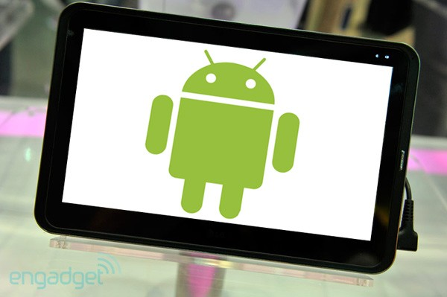
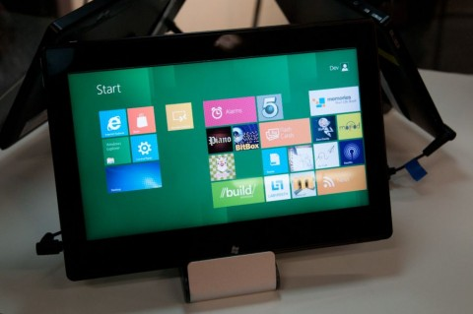
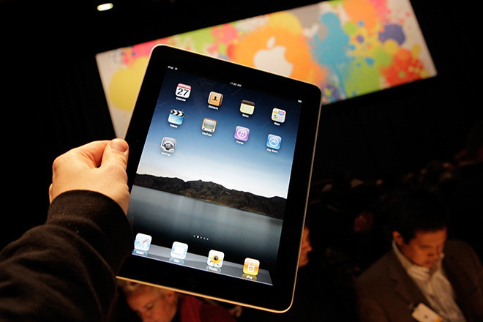
Touchscreen Devices
Why?
New technology, becoming common
Touch-driven input paradigm
Games need to be redesigned
Android tablets, iPads, Windows 8
Progress Report, CIS 400, Fall 2011
Philip Peng, 2011/12/07

Slide 15
Project Proposal
Goal:
Design, prototype, and evaluate different rhythm games interfaces for touchscreen devices.
Approach:
Create a rhythm game prototype for Android tablets that demos various game interfaces and collects usage data to evaluate their effectiveness.
Progress Report, CIS 400, Fall 2011
Philip Peng, 2011/12/07

Slide 16
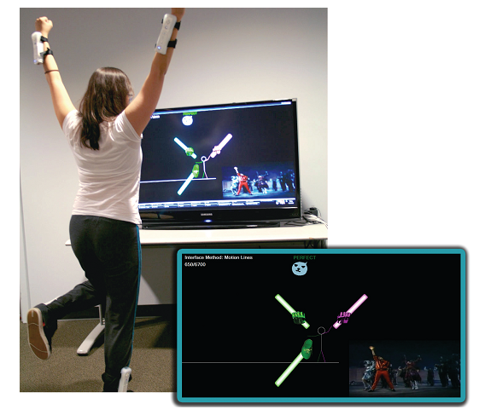
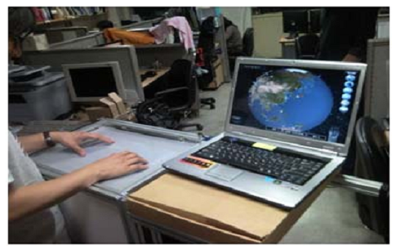
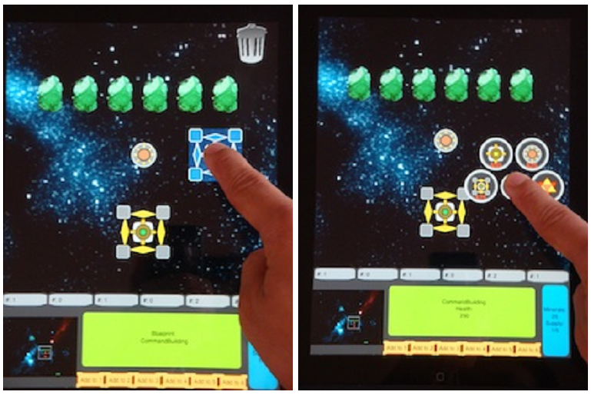
Related Work
Wiimote + Dance Game
“Understanding Visual Interfaces for the Next Generation of Dance-Based Rhythm Video Games” – University of Central Florida, Orlando, FL
External Multi-touch Panel + Turn-Based Strategy Game
“A Study on Multi-Touch Interface for Game” – Chung-Ang University, Seoul, Korea
Overlayed Multi-touch Screen + Real-Time Strategy Game
“One-handed Interface for Multi-Touch Enabled Real-Time Strategy Games” – University of California, Santa Cruz, CA
Progress Report, CIS 400, Fall 2011
Philip Peng, 2011/12/07

Slide 17
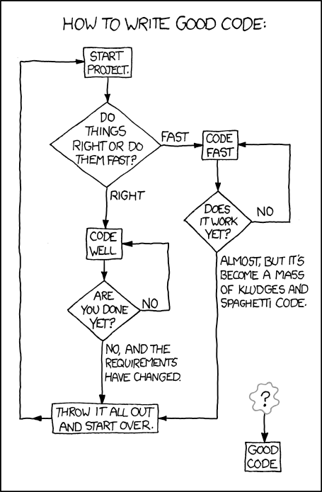
Project Outline
Design – Draft
Interface visualization?
Categorize/compare?
Reduce variables?
2) Prototype – Code
Combined app?
What framework?
Common engine?
3) Evaluation - Data
Measurable metrics?
Sample surveys?
Compare trends?
Progress Report, CIS 400, Fall 2011
Philip Peng, 2011/12/07

Slide 18
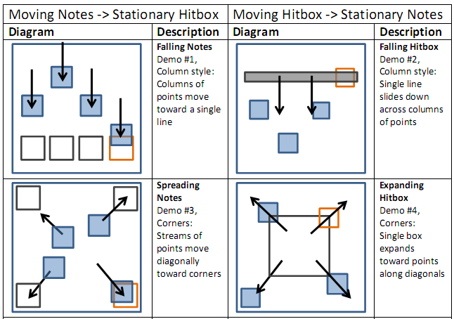
Design – Interfaces #1-4
Progress Report, CIS 400, Fall 2011
Philip Peng, 2011/12/07

Slide 19
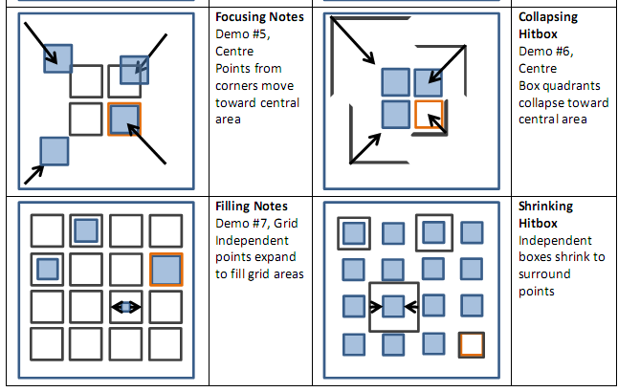
Design – Interfaces #5-8
Progress Report, CIS 400, Fall 2011
Philip Peng, 2011/12/07

Slide 20
Prototype – Application Layout
Android App
Demo #1
#2
#3
Interface
Common
Notes Obj
Music Player
Button Obj
…
Progress Report, CIS 400, Fall 2011
Philip Peng, 2011/12/07
Timer
Hitbox Obj
Score Keeper
Touch Handler
Data Tracker
Main Menu
External Database

Slide 21
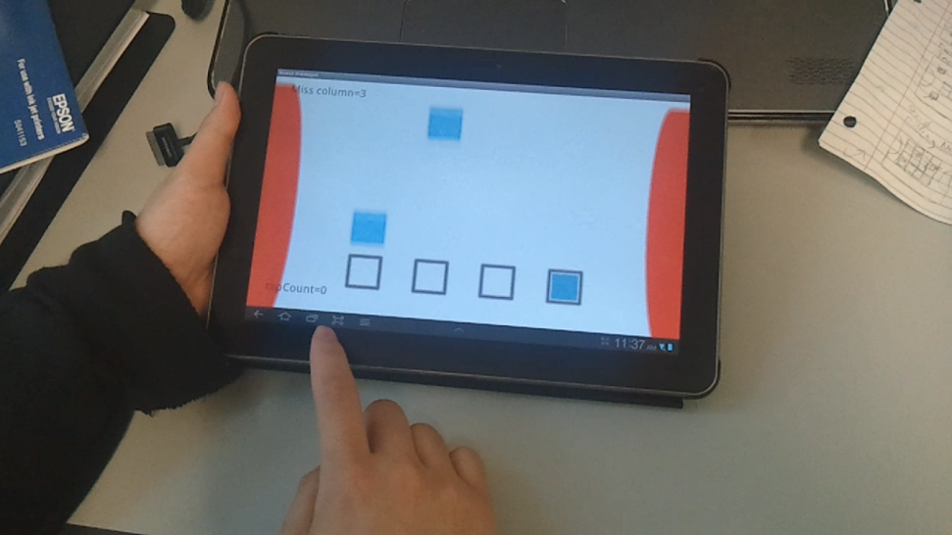
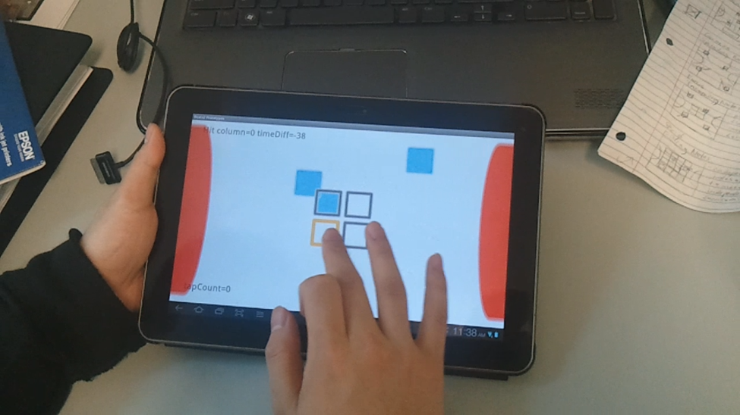
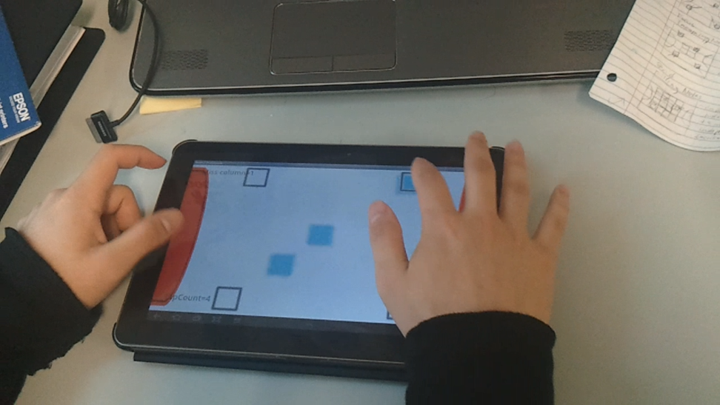
Prototype – Demo Video (WIP)
Beats2: prototypes
Progress Report, CIS 400, Fall 2011
Philip Peng, 2011/12/07

Slide 22
Evaluation
Quantitative Measurements
Attention load:
Button presses count
Button press average frequency
Timing accuracy
Note hit/miss count
Note hit average score
Demo #1 “Falling Notes” = comparison baseline
Progress Report, CIS 400, Fall 2011
Philip Peng, 2011/12/07

Slide 23
Evaluation
Qualitative Surveys
* = compare perceived results with qualitative results
Criteria | Description | Rating
Challenge* | Did the demo require lots of skill (e.g. timing with hand-eye coordination)? | Easy --> Hard
Concentration* | Did the demo require a high amount of attention (e.g. less focus on hitting the buttons)? | Low --> High
Fun | Did you enjoy playing the demo (relative to the other demos)? | Boring --> Fun
Mastery | Did you find the demo’s interface intuitive and easy to learn/use? | Easy --> Hard
Uniqueness | Did you find the demo’s interface and gameplay new and unique? | Old --> New
Progress Report, CIS 400, Fall 2011
Philip Peng, 2011/12/07

Slide 24
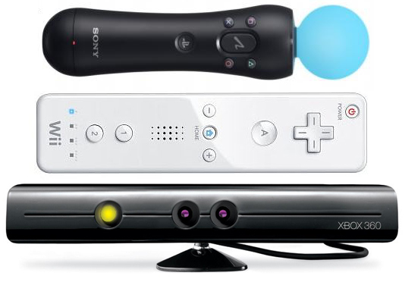
Stretch Goals
Unity3
Port to Unity3 engine
Add touch gestures (hold, slide, etc.)
2.5D graphics with perspectives
Desktop and iOS support?
Kinect/Wiimote
Supported via Unity3 plugin
Virtual touch grid (depth-based)
Different input, same overall interface concepts
Beats2
Support alternate interfaces based on the results of study and user feedback
Use same base engine
Progress Report, CIS 400, Fall 2011
Philip Peng, 2011/12/07

Slide 25
Remaining Work
Work Item | Description | Estimation
Interface demos | Complete interface demos #2, 4, 6, 7, 8 Requires modifying hitbox behaviour Modify graphics loader or add rotation support | 3 weeks
Rhythm game engine | Add synchronized music player Add notes data parser (borrow from Beats?) | 3 weeks
Data tracker | Add data tracking/survey feedback system (use Google Analytics or custom server?) | 2 weeks
Graphics and documentation | Create better, publishable graphics Cleanup and comment code, write documents | 1 week
Sample survey | Selective surveying of friends and classmates | 1 week
Mass survey | Large-scale surveying via Market publishing | 3 weeks
Evaluation | Statistical analysis on collected results | 1 week
Report | Write final report, update website | 1 week
Progress Report, CIS 400, Fall 2011
Philip Peng, 2011/12/07

Slide 26
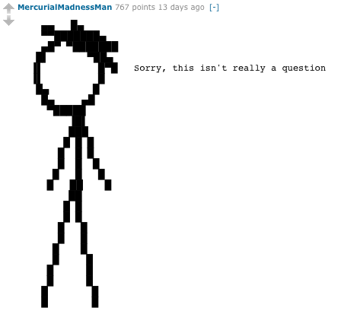
Questions?
Progress Report, CIS 400, Fall 2011
Philip Peng, 2011/12/07

