Slide 1
Rhythm Game Development Toolkit For
Touchscreen Devices
Project Proposal, CIS 400, Fall 2011
Philip Peng, 2011-10-25
2
Members: Philip H. Peng
Advisor: Dr. Stephen H. Lane
CIS 400, Fall 2011, University of Pennsylvania
All images used in this belong to their rightful owners

Slide 2
Problems/Motivation
Touchscreen Devices
New technology, becoming common
Touch-driven input paradigm
Games need to be redesigned
Rhythm Games
Many kinds, common backend
Each game designed for specific game mode
Specialized hardware
Inaccessible, uncommon
Few rhythm games for touchscreens (-Beats)
Project Proposal, CIS 400, Fall 2011
Philip Peng, 2011-10-25

Slide 3
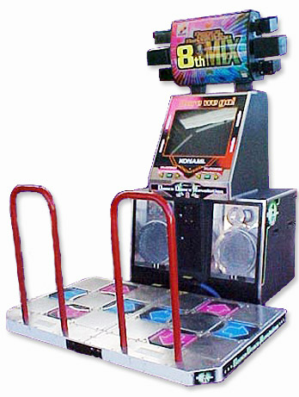
Related Work
Relevant Games
Parappa The Rapper, Beatmania, Pop ‘N Music, Dance Dance Revolution, Taiko No Tatsujin, Guitaroo Man, Osu! Tatakae! Ouendan!, Guitar Hero, jubeat, DJMAX Technika, Hatsune Miku: Project DIVA
Simulators
StepMania, BM98, Frets on Fire, osu!, Project –Project DXXX–, Youbeat
Beats
http://beatsportable.com
Released 1yr ago, for Android phone + tablets
350k+ downloads so far, 4.6/5.0 avg rating
Project Proposal, CIS 400, Fall 2011
Philip Peng, 2011-10-25

Slide 4
Approach
Three targets:
Usability Cross-platform, open source, easy to port, modular and easy to extend
Multi-Mode Components allow for support of multiple gameplay modes and data formats
Touch-Driven Interface and input components designed for touch-driven input paradigm
Project Proposal, CIS 400, Fall 2011
Philip Peng, 2011-10-25

Slide 5
Approach: Usability
Features
http://code.google.com/p/beats2
Open source, Modified BSD License
Unity 3: cross-platform, large dev community
Toolkit vs Framework
Modular, independent components
Three test targets: Samsung Galaxy S: smartphone, Android Samsung Galaxy Tab 10.1: tablet, Android Dell XPS L702X: touchscreen laptop, Win 7/8
Project Proposal, CIS 400, Fall 2011
Philip Peng, 2011-10-25

Slide 6
Approach: Multi-Mode
Parser Formats
step/DDR: StepMania .sm, DWI .dwi
pump/Pump It Up Pro: KIU .ksf
beat/Beatmania: BM98 .bms/.bme
pop/Pop ‘N Music: Feeling Pomu .pms
guitar/Guitar Hero: Frets on Fire .ini
diva/Project DIVA: PPD .ppd
box/jubeat: Youbeat .txt
taiko/Taiko no Tatsujin: osu! .osu
osu/Osu! Tatakae! Ouendan!: osu! .osu
technika/DJMAX Technika, N/A
Project Proposal, CIS 400, Fall 2011
Philip Peng, 2011-10-25

Slide 7
Approach: Multi-Mode
Pattern Modes
Fade/appearing notes
Scrolling notes sheet
Pathed-motion notes
Sliding hitbar
Backend
Configurable timing/accuracy tracker
Multiple scoring systems (DDRMAX2, osu, etc)
Common notes data format
Converters between data formats
Project Proposal, CIS 400, Fall 2011
Philip Peng, 2011-10-25

Slide 8
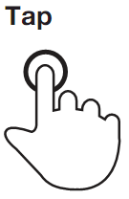
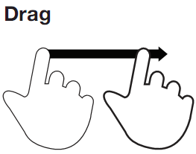
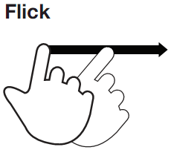
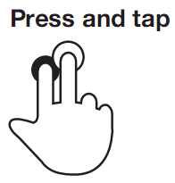
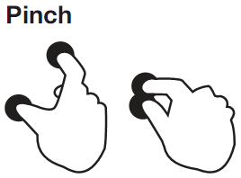
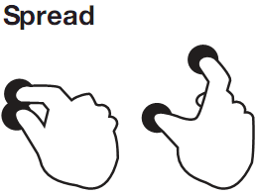
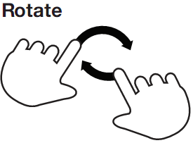
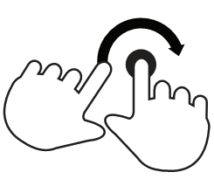
Approach: Touch-Driven
Input Gestures
From “Touch Gesture Reference Guide” http://www.lukew.com/touch/TouchGestureGuide.pdf
(Hold)
(Slide)
(Swipe)
Project Proposal, CIS 400, Fall 2011
Philip Peng, 2011-10-25
(Spin)

Slide 9
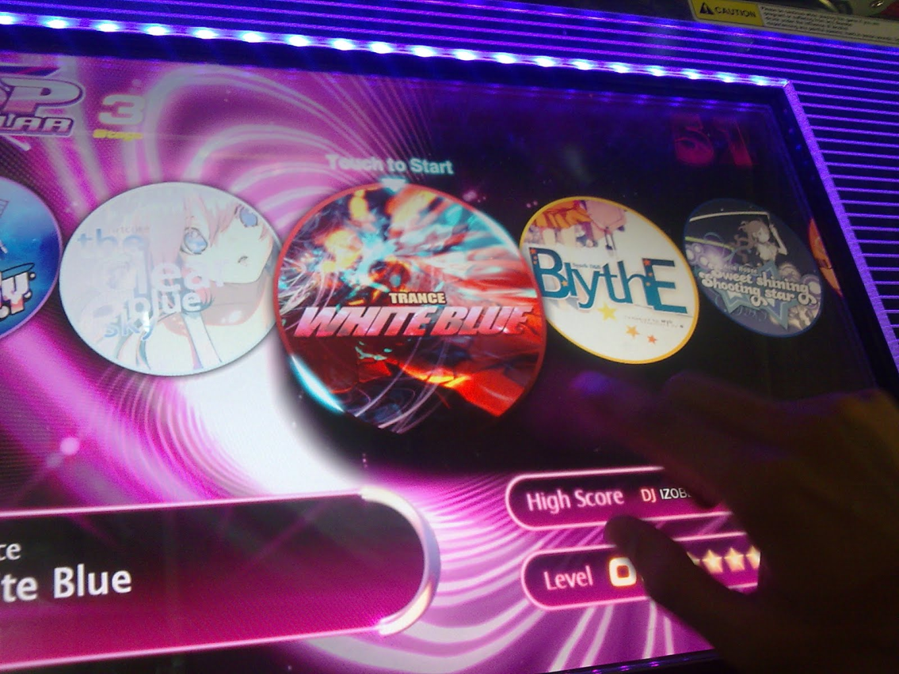
Approach: Touch-Driven
User Interface
NUI (coverflow, grids, large icons, etc.)
All gesture-input (not just taps)
Game modes support touch gestures
AVH elements (sfx/gfx, haptic feedback)
Project Proposal, CIS 400, Fall 2011
Philip Peng, 2011-10-25
DJMAX Technika menus are a good example

Slide 10
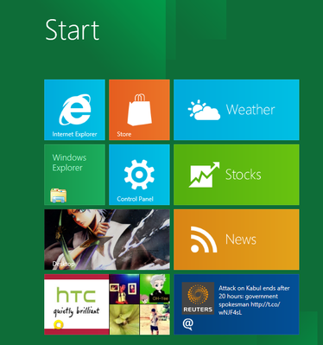
Approach: Technical
Tools/Resources
Unity 3 Engine
Android SDK
Immersion’s UHL
Windows 8 Dev Preview tools
Additional A/V playback codecs
Google Code (svn + wiki + tracker)
Crowdin (crowd-sourced translations)
Google Analytics (via Unity 3)
Project Proposal, CIS 400, Fall 2011
Philip Peng, 2011-10-25

Slide 11
Approach: Components
Unity 3 Engine
Backend
Input
Graphics
Media
Parser
Basic touch
Canvas
Music Player
Shapes
Project Proposal, CIS 400, Fall 2011
Philip Peng, 2011-10-25
Converter
Gestures
Sound FX Loader
Text
Timing
Haptic Feedback
Sprites
Video Player?
Scoring
Accelerometer/ More Hardware
Animation

Slide 12
Approach: Demo – Beats2
Prototype
Multi-mode rhythm game simulator
Support step, beat, box, technika
Supports tap, hold, slide, swipe
Runs on Windows 7 and Android
Beta published on Android Market
Stretch Goals
Supports all modes
Supports all gestures
Runs on Windows 8
XBOX Kinect integration
Community-contributed content and involvement
Project Proposal, CIS 400, Fall 2011
Philip Peng, 2011-10-25
2

Slide 13
Timeline
M0 – 3 weeks (Nov 18th)
Investigate Unity 3 Engine, obtain license
Set up Google Code/resources
M1 – 3 weeks (Dec 9th)
Draft toolkit specifications
Draft Beats2 game design
Component prototypes
M2 – 5 weeks (Feb 3rd)
Complete basic Backend components
Complete basic Input components
M3 – 6 weeks (Mar 16th)
Complete basic Media components
Complete basic Graphics components
M4 – 5 weeks (Apr 20th)
Working prototype of Beats2
M5 - Remainder
Documentation
Improve/debugging Beats2
Stretch Goals
Project Proposal, CIS 400, Fall 2011
Philip Peng, 2011-10-25

