Slide 1
Linux Everywhere
A look at Linux outside the world of desktops
CIS 191 Spring 2012 – Guest Lecture by Philip Peng

Slide 2
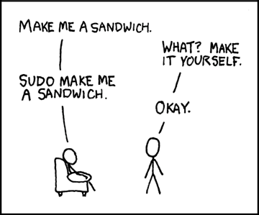
Lecture Outline
Introduction
Different Platforms
Reasons for Linux
Cross-compiling
Case Study: iPodLinux
Questions

Slide 3
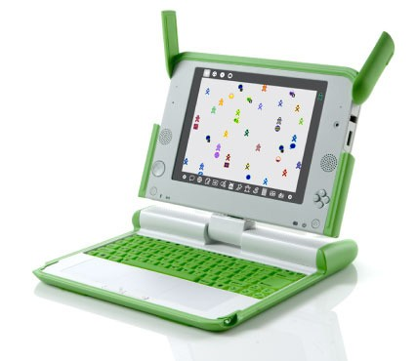
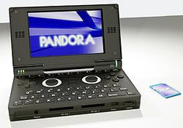
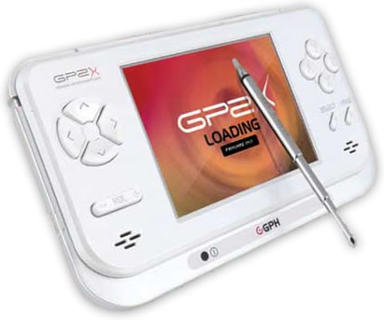
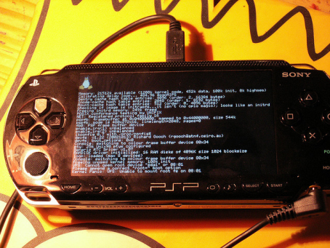
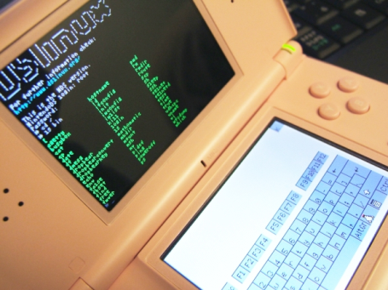
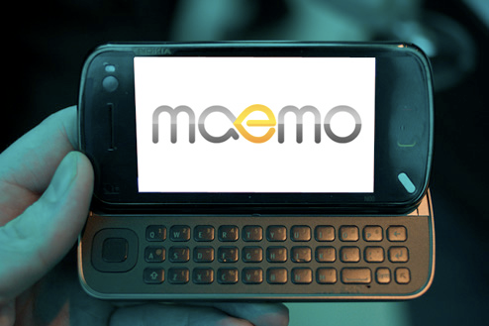
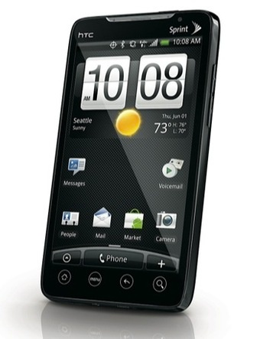
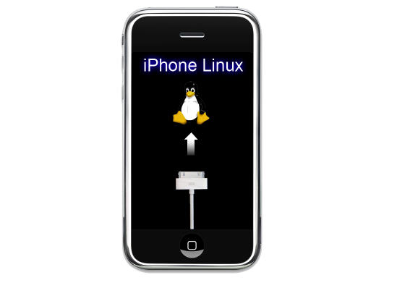
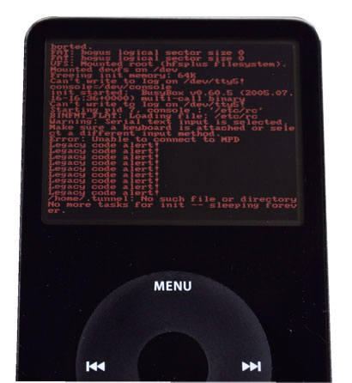
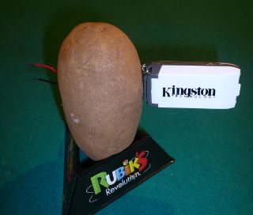
What’s in common?
Notes:
Put your hands up if you recognize at least 1 of these devices. Keep your hands up if you recognize at least 2? 3 or more?
Put your hands up if you know what all these devices share in common
(They all run Linux!)

Slide 4
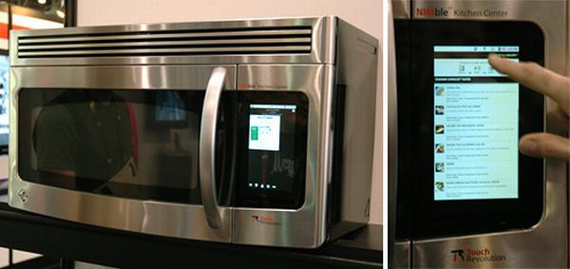
All your hardware are belong to us
Linux is everywhere
If its programmable, you can put Linux on it!
Yes, even a microwave
CES 2010, microwave running Android: http://www.handlewithlinux.com/linux-washing-cooking

Slide 5
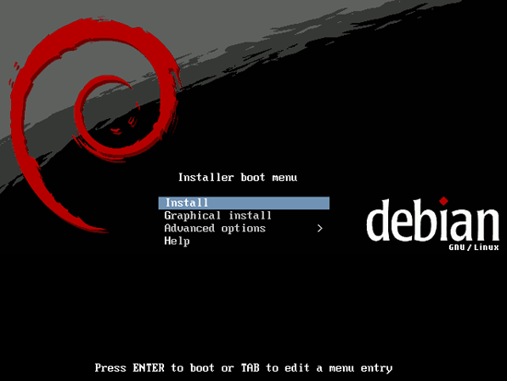
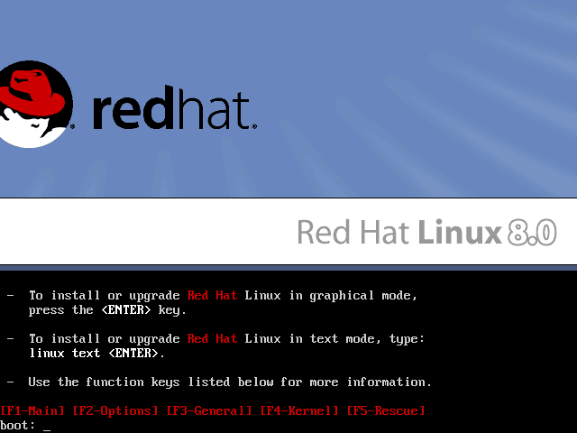
Servers
What servers use
Stability, security, free
Examples:
CentOS
Debian
Red Hat

Slide 6
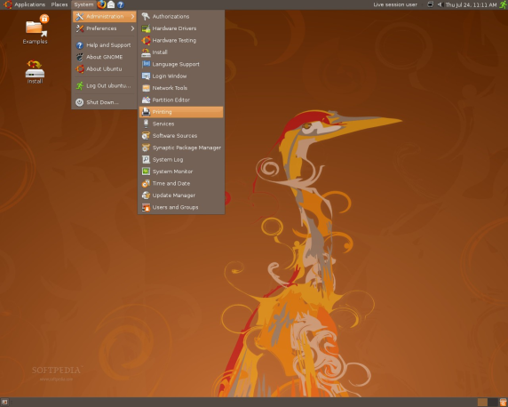
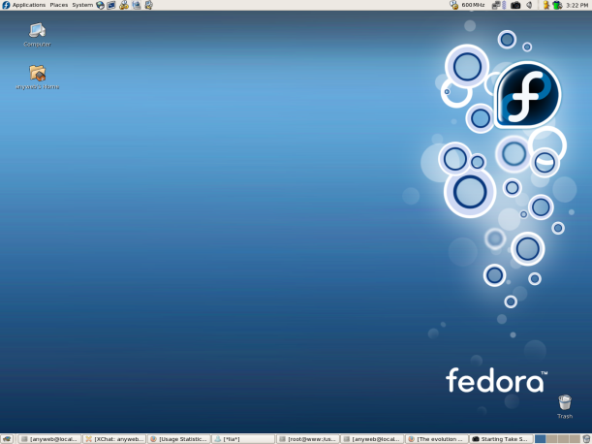
Desktop
What you use
Free Windows/Mac alternative
Examples:
Ubuntu
Fedora
PCLinuxOS

Slide 7
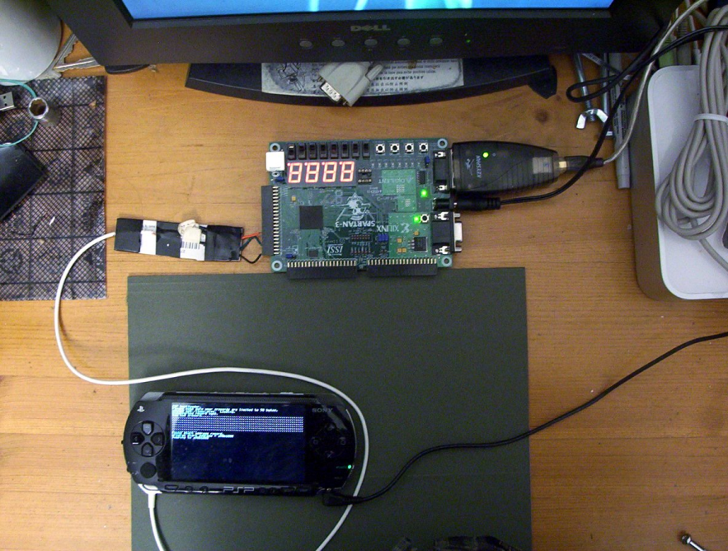
Gaming Devices
What (white-hat) hackers do
To run “homebrew” software
Examples:
PS3, Wii, XBOX
PS2, GameCube
Dreamcast
PSP, DS
Open Pandora, GP2X

Slide 8
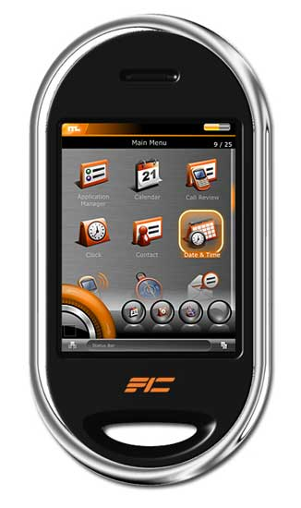
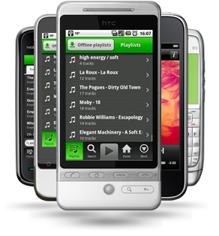
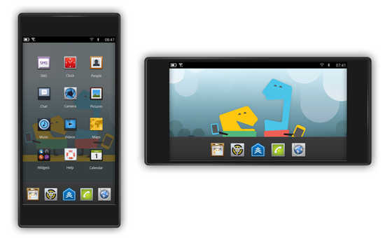
Mobile Devices
What distributors are developing
Community contribution
Examples
Android
Maemo/MeeGo/Tizen
Openmoko

Slide 9
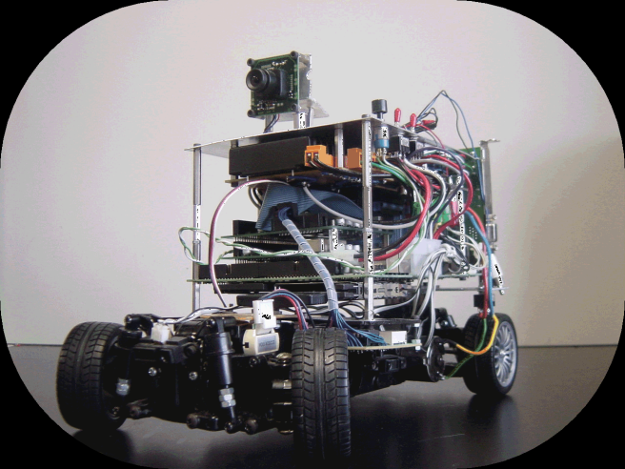
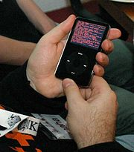
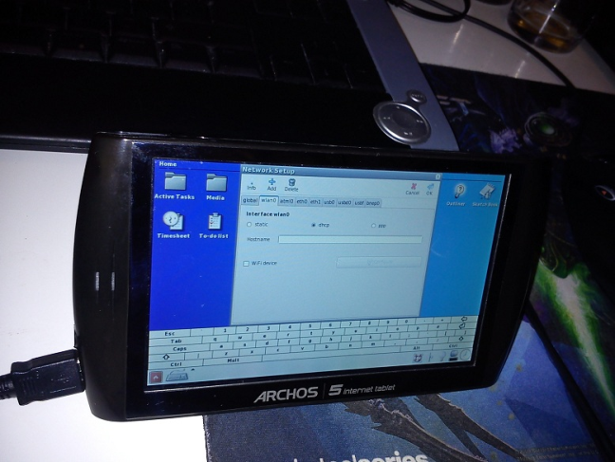
Embedded Devices
What embedded hardware run
Small footprint, dev tools
Examples
RTLinux (real-time)
μClinux (no MMU)
Ångström (everything)

Slide 10
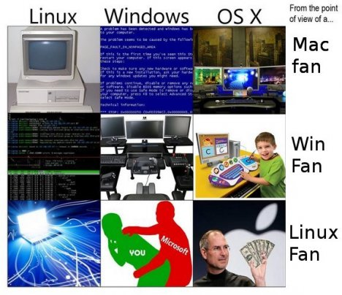
Why?

Slide 11
Free!
Free!
As in freedom, i.e. open source
As in beer, i.e. vs paid upgrades

Slide 12
Homebrew!
Run own software
Your hardware → your software?

Slide 13
Support!
Community contribution
“For the greater good” (i.e. users)
Everyone contributes
Specialists from all over the world
Existing hardware support
Many already supported computer architecture
Modify existing drivers

Slide 14
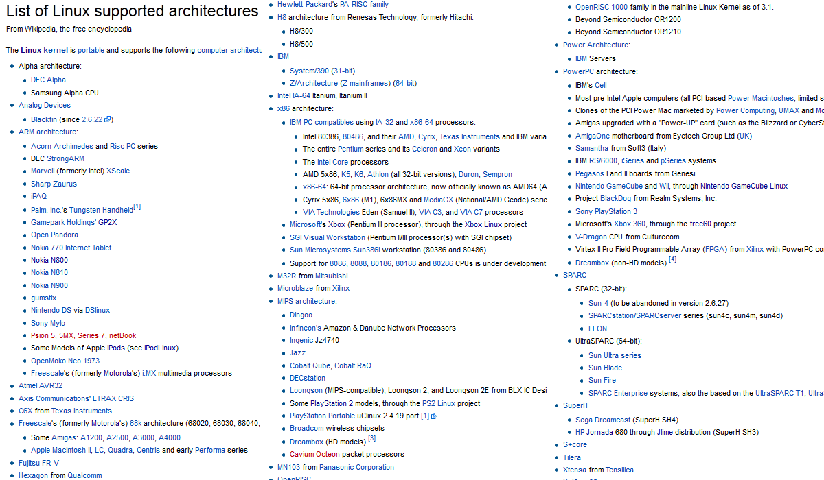
Lots of support!

Slide 15
Why not?
Because we can
If its hackable, it can run Linux

Slide 16
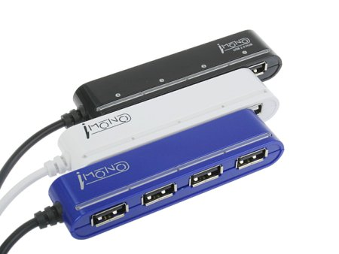
How?
How do we get Linux running on XXX?
Port: A version of software modified to run on a different target platform
The PS3 port of Fedora is a modified build of Fedora compiled to run on the PS3 architecture
e.g. “I ported the Linux kernel to my iPod”

Slide 17
Cross-compiling!
Supported hardware? Easy! Cross-compile!
Compiler: A program that converts code to an executable program for your computer
Cross-compiler: A program that converts code to an executable program for another platform

Slide 18
Cross-compiling!
What makes this possible? C and gcc
C programming language is made to be easily portable to different architectures
The Linux kernel and all basic tools are written in C
Same source code runs of all sorts of platforms

Slide 19
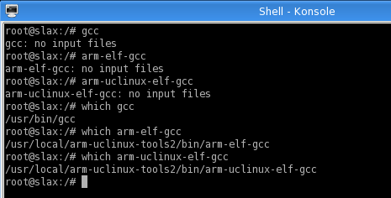
Multiple Compilers
“arm-elf” is the architecture that runs ELF executables (default format for Linux) on an ARM processor
μClinux is a Linux kernel fork for microcontrollers without a MMU (memory management unit)

Slide 20
Compiling for LFS (i368 Linux)
Compiling tar for LFS (you did this for HW!)
# wget http://ftp.gnu.org/gnu/tar/tar-1.26.tar.bz2
# tar -xf tar-1.26.tar.bz2
# cd tar-1.26
# ./configure
# make

Slide 21
Compiling for arm-elf
Compiling tar for arm-elf architecture
# wget http://ftp.gnu.org/gnu/tar/tar-1.26.tar.bz2
# tar -xf tar-1.26.tar.bz2
# cd tar-1.26
# ./configure CC=arm-elf-gcc LDFLAGS=-elf2flt –-host=arm-elf
# make

Slide 22
Compiling for arm-elf
# ./configure CC=arm-elf-gcc LDFLAGS=-elf2flt –-host=arm-elf
CC=arm-elf-gcc
Specify the “cross-compiler” to be used
LDFLAGS=-elf2flt
Set any special linking flags (e.g. target specific)
In this case, convert ELF to bFLT format
--host=arm-elf
Specify the host machine that you are building for

Slide 23
Compiling for arm-elf
Result:
Native tar is in ELF format, cross-compiled is bFLT format
Native tar can execute, cross-compiled tar can’t (not on the build computer at least)

Slide 24
Cross-compiling Terminology
Note on compiling terms: build, host, target
Build: platform that you are building on
Usually unspecified (since almost always Linux)
Host: platform that you are building for
For cross-compiling, e.g. arm-elf architecture
Target: machine that you are building for
For cross-compiling, only specified for special cases with different output formats

Slide 25
That was easy!
Review: To cross-compile Linux for a supported platform, just add a few config flags, and run make!
That was easy!
=

Slide 26
But wait, there’s more!
But what happens if you want to run Linux on an unsupported platform?
Too bad, you’ll have to port it yourself!
=

Slide 27
Porting Linux = Hard
Porting Linux in a nutshell:
Gather as much information about the hardware
Reverse-engineer any currently existing software
Modify the cross-compiling tools to generate binaries compatible with the new architecture
Modify the kernel source code to support communicating with the various hardware components
LFS all-over-again! (Except it probably won’t work the first time, or even the second)

Slide 28
Porting Linux = Hard
Porting Linux minimum requirements:
C programming
Linux (CIS 191)
Compilers (CIS 341)
OS concepts (CIS 380)
Computer architecture (CIS 501)
Experience with hardware debugging (e.g. JTAG)
In-depth knowledge of the assembly language of the target architecture (e.g. x86, ARM, MIPS, etc.)

Slide 29
Why bother?

Slide 30
So you can do this

Slide 31
Case Study: iPodLinux

Slide 32
What is iPodLinux
iPodLinux = iPod + Linux
Custom port of μClinux to the old iPod hardware
Goal to turn your iPod into more than just an MP3 player
Real reason: Because we can!
Wiki: http://ipl.derpapst.eu IRC: #ipodlinux@irc.freenode.net Code: http://sourceforge.net/projects/ipodlinux/

Slide 33
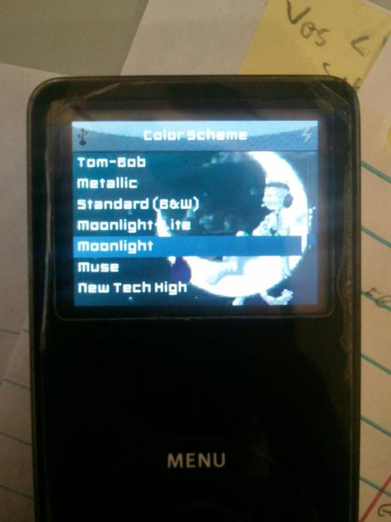
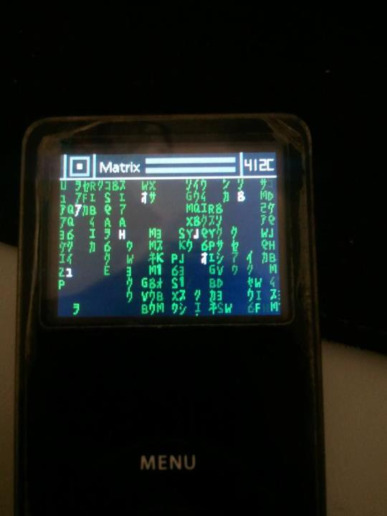
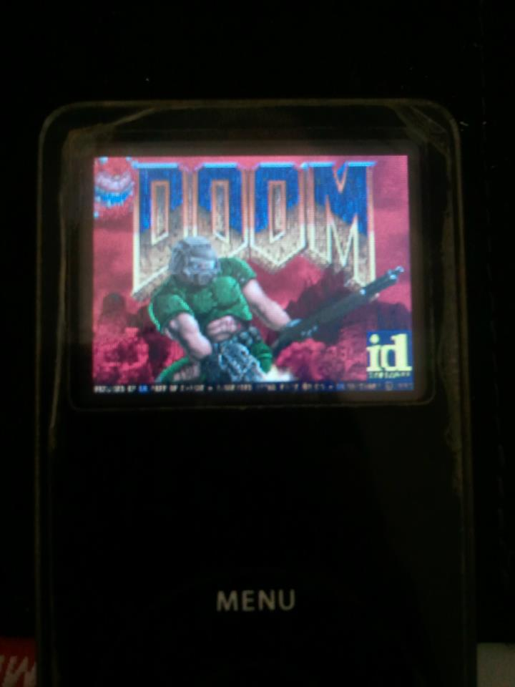
The Features - Software
Customizable user interface
File-browser and plugin support
Music player w/ OGG & FLAC support
Video playback with sound
Many user-ported Linux applications and emulators

Slide 34
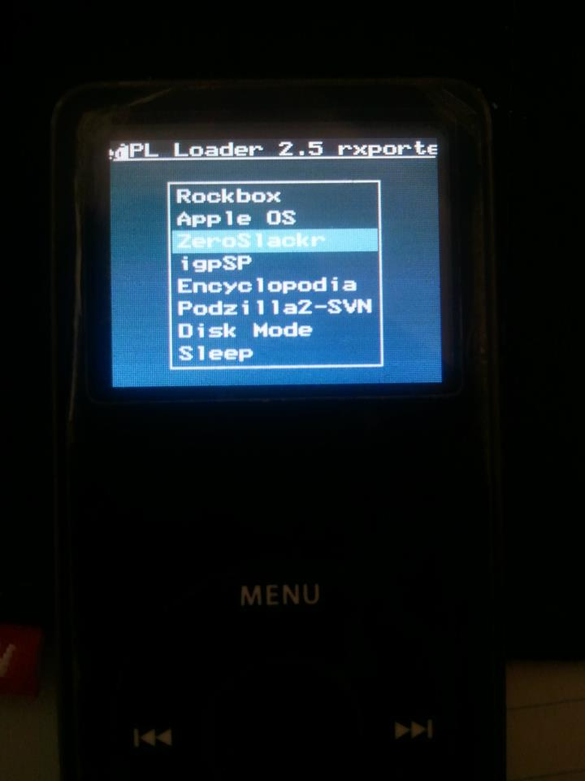
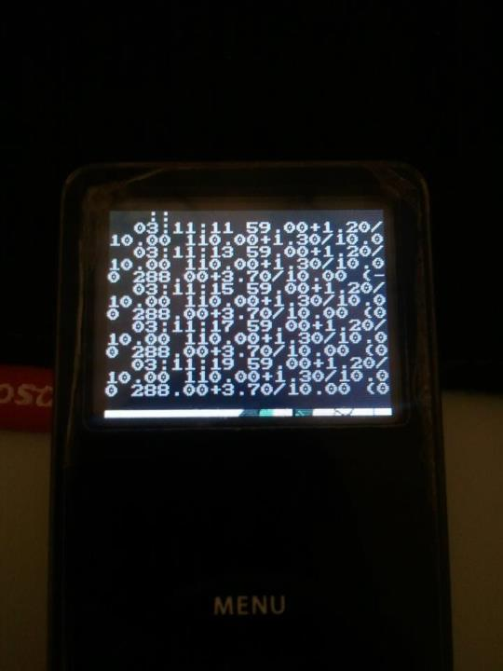
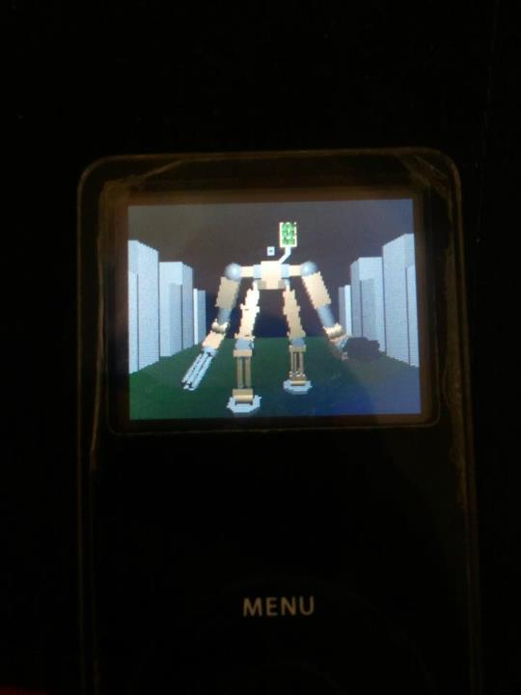
The Features - Hardware
Custom graphical bootloader
Playback of audio with piezo (scroll “clicker”)
Audio-recording via headphone jack
Backlight brightness control
Overclocking CPU to 80MHz (vs Apple’s 66MHz)

Slide 35
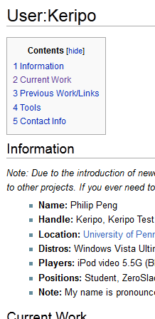
My contribution
Joined official dev team in 2008
Free iPod gift? Lets hack it!
Sansa e200 kernel patches
podzilla2 features + bug fixes
Experimental kernel builds
Compiling tutorials + tools
Wiki and forum maintenance
See http://ipl.derpapst.eu/wiki/User:Keripo

Slide 36
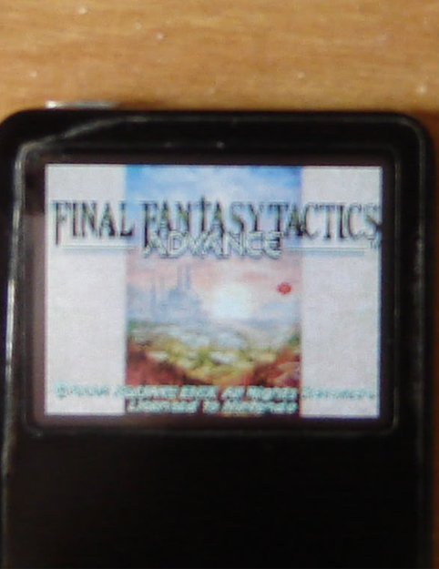
My contribution
Project ZeroSlackr
Custom, non-destructive iPL installation system
Ported numerous third part applications:
igpSP – Gameboy Advanced emulator
hDoom – original Doom video game
hWolf3D – original Wolfenstein3D
… and much more
See http://sourceforge.net/projects/zeroslackr/

Slide 37
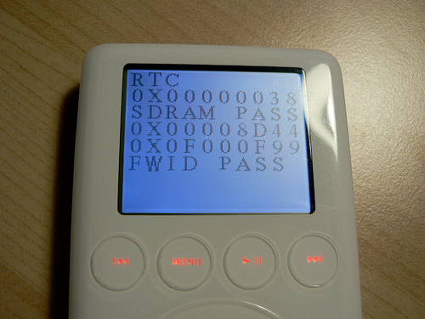
History Bit: Reverse Engineering
Problem: No source code/documentation
Solution: Reverse engineer it!
Software not encrypted, can be dumped through hardware means
Apple left in a Diagnostic Mode
iPodLinux project goes live in 2003
More: http://web.archive.org/web/20070224164831/http://www.ipodlinux.org/blog/

Slide 38
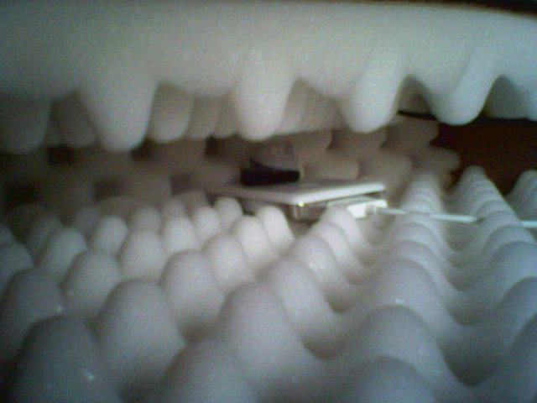
History Bit: Piezo Hack
Problem: Can’t dump iPod 4G bootloader
Solution: Record it bit-by-bit!
Use the piezo (“clicker”) to read the bootloader code as sound
Put iPod in sound-proof chamber
Leave iPod on overnight, decode the audio recording the next day
More : http://web.archive.org/web/20070519081643/http://www.ipodlinux.org/stories/piezo/

Slide 39
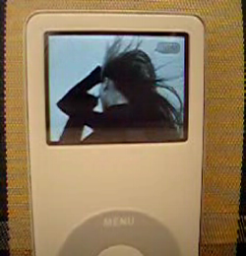
History Bit: We had video first!
Problem: Still pictures on Apple’s new iPod Photo is boring, 2005
Solution: Lets add video support!
Uncompressed, 15fps, A/V issues
Apple responds a year later with the iPod 5G, the “iPod video” ; (
We did it first! Still counts!
More : http://ipl.derpapst.eu/wiki/Video_Player

Slide 40
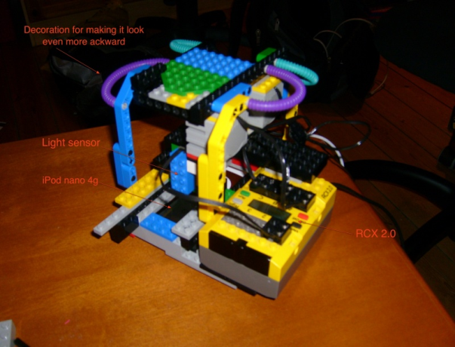
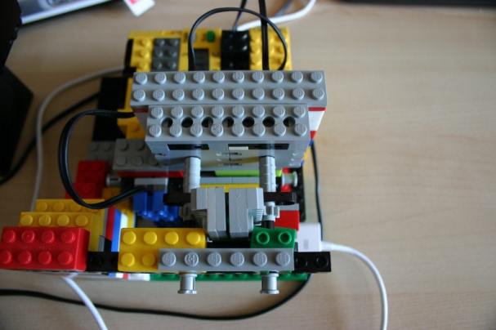
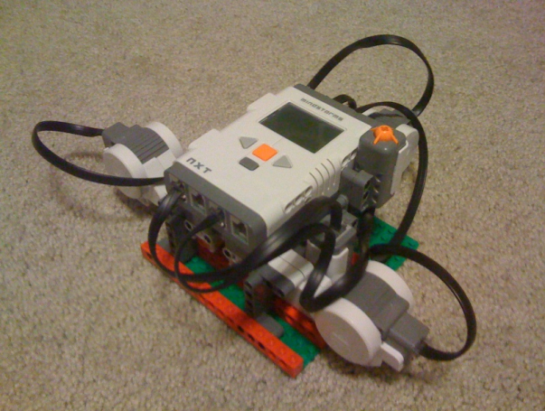
History Bit: Nanotron 3000
Problem: iPod nano 2G encrypted, 2006
Solution: Find an exploit!
Buffer overflow in Notes functionality (no bound check beyond 268 chars in <a href> links)
Use LEGO Mindstorm to brute-force the jump address location
More : http://www.freemyipod.org/wiki/Nanotron_3000

Slide 41
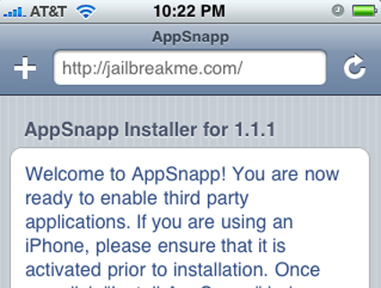
History Bit: iPhone
Problem: Apple releases iPhone and iPod Touch in 2007
Solution: None, it was a good run ; (
Go work on other cool projects!
davidc (David Carne) worked on jailbreakme.com
AriX (Ari Weinstein) worked on iJailbreak
I work on Android and TA this course (Linux!)
More: http://www.tuaw.com/2007/10/29/instant-jailbreak-for-iphone-and-ipod-touch/ More: http://online.wsj.com/article/SB124692204445002607.html

Slide 42
Questions?

