Slide 1
gpu-Accelerated Video Encoding/Decoding
CIS 565 Spring 2012
Philip Peng, 2012/03/19

Slide 2
Overview
Motivation
NVIDIA GPU
Compression Techniques
NPP & Performance
NVIDIA API Demo

Slide 3
Motivation
Why use GPU?

Slide 4
Motivation
Why video encoding/decoding?
Large part of consumer activities
Watch YouTube videos everywhere
Encode HD videos to iPhone/etc.
Img src: http://cdn3.digitaltrends.com/wp-content/uploads/2010/07/youtube-and-iphone-20.jpg
Notes:
PC, mobile, tablet

Slide 5
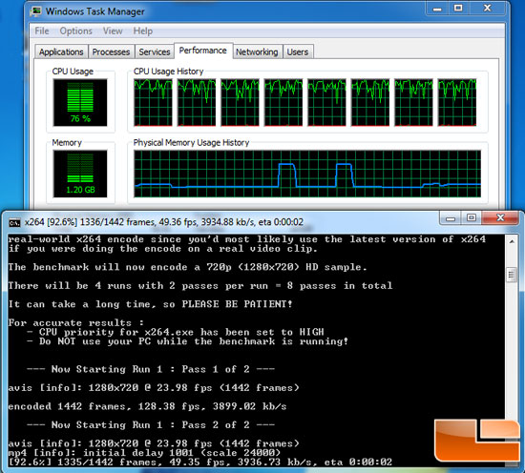
Motivation
Why use GPU?
Portable devices have limited processing power
Very computationally intensive
Faster + smaller = better
Img src: http://www.legitreviews.com/images/reviews/1501/x264_cpu.jpg
Notes:
Modern day mobile devices (e.g. phones) have GPUs now
Faster = for same result, faster runtime
Smaller = for same time, smaller filesize

Slide 6
NVIDIA GPU
What’s currently out there?

Slide 7
NVIDIA GPU Video Encoding
Facilities
SW H.264 codec designed for CUDA
Supports “baseline”, “main”, “high” profiles
Interfaces:
C library (NVCUVENC)
Direct Show API
Win 7 MFT (multimedia framework)
Notes:
MFT = Media Foundation Transforms, component of the multimedia framework

Slide 8
NVIDIA GPU Video Decoding
Facilities
HW GPU acceleration
H.264, VC1, MPEG2
SW MPEG2 decoder designed for CUDA
Interfaces:
C library (NVCUVIV) – HW & SW
DXVA & Win7 MFT – HW only
VDPAU library – HW only (Linux)
Notes:
DXVA = DirectX Video Acceleration API for Windows
VDPAU = Video Decode and Presentation API for Unix

Slide 9
Compression Techniques
How is it done?

Slide 10
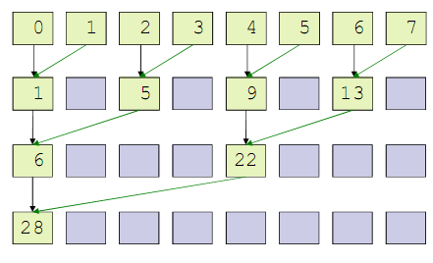
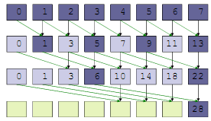
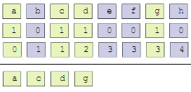
GPU Algorithm Primitives
Fundamental building blocks for Parallel Programming
Reduce: sum of absolute differences
Scan: integral image calculations
Compact: index creation
CUDA C SDK, CUDPP, Thrust implementations
Img src: http://cis565-spring-2012.github.com/lectures/02-01-Parallel-Algorithms.pdf
Notes:
Same primitives we learned about
See “Parallel Algorithms” lecture, Feb 1st
CUDPP = CUDA Data Parallel Primitives Library

Slide 11
Technique: Intra Prediction
Img src: http://www.nvidia.com/content/GTC-2010/pdfs/2075_GTC2010.pdf
Notes:
Rough example, obviously not full compression
Lossy
Intra Prediction can run in parallel, see NVIDIA PDF for source code example

Slide 12
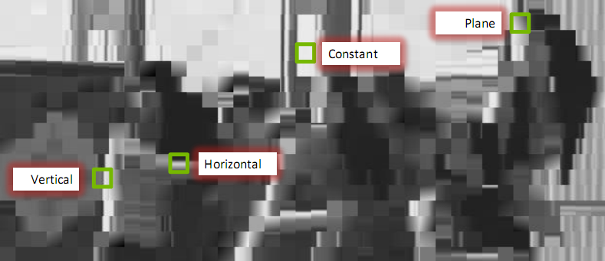
Technique: Intra Prediction
Img src: http://www.nvidia.com/content/GTC-2010/pdfs/2075_GTC2010.pdf
Notes:
Rough example, obviously not full compression
Lossy
Intra Prediction can run in parallel, see NVIDIA PDF for source code example

Slide 13
Technique: Intra Prediction
Video processing technique via content prediction
Uses data within single video frame
Divides frame into blocks
Prediction rules
Constant: each pixel constant value
Vertical: each row uses top predictor
Horizontal: each column uses left predictor
Plane: gradient diagonal prediction
Img src: http://www.nvidia.com/content/GTC-2010/pdfs/2075_GTC2010.pdf
Notes:
Four basic rules
Predictor = top row, left column

Slide 14
Technique: Intra Prediction
For each block, calculate SAD between predicted pixels and actual
Choose predictor with lowest prediction error
Data compression = only store predictors and prediction rules
Img src: http://www.nvidia.com/content/GTC-2010/pdfs/2075_GTC2010.pdf
Notes:
SAD = Sum of Absolute Differences

Slide 15
Technique: Motion Estimation
Img src: http://www.nvidia.com/content/GTC-2010/pdfs/2075_GTC2010.pdf

Slide 16
Technique: Motion Estimation
Img src: http://www.nvidia.com/content/GTC-2010/pdfs/2075_GTC2010.pdf

Slide 17
Technique: Motion Estimation
Img src: http://www.nvidia.com/content/GTC-2010/pdfs/2075_GTC2010.pdf
Notes:
Motion Vectors Field (MVF) = change in blocks

Slide 18
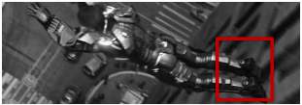
Technique: Motion Estimation
Img src: http://www.nvidia.com/content/GTC-2010/pdfs/2075_GTC2010.pdf
Notes:
Can be used to generate a “residual” image to show difference between frames

Slide 19
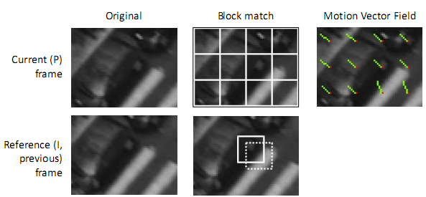
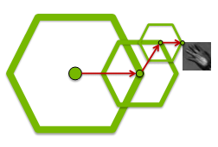
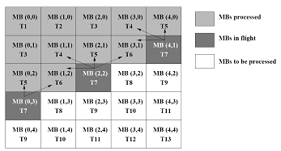
Technique: Motion Estimation
Many different search algorithms for calculating motion vectors:
Full search: brute force feature comparison
Diamond search: template-based iterative matching
2D/3D-wave: diagonal block-based checking
Combination done in parallel on GPU
Img src: http://www.nvidia.com/content/GTC-2010/pdfs/2075_GTC2010.pdf

Slide 20
NPP & Performance
GPU vs CPU

Slide 21
NVIDIA Performance Primitives
What is it?
NPP = C library of GPU-accelerated functions/primitives designed for CUDA
API same as IPP (Intel Integrated Performance Primitives)
No GPU architecture knowledge required!
5-10x faster performance vs CPU-only implementations
http://developer.nvidia.com/npp
Notes:
image, video and signal processing

Slide 22
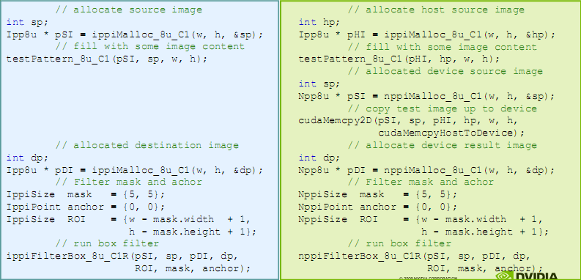
NVIDIA Performance Primitives Code
Img src: http://www.nvidia.com/content/GTC/documents/1028_GTC09.pdf
Notes:
image, video and signal processing

Slide 23
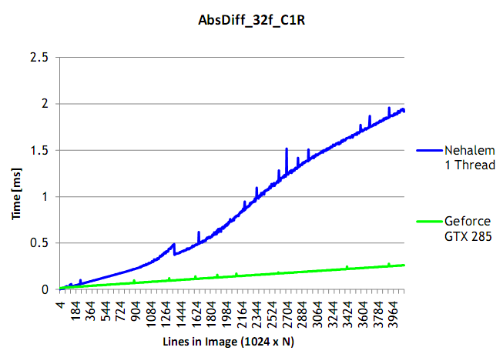
NVIDIA Performance Primitives Tests
Data scalability:
Img src: http://www.nvidia.com/content/GTC/documents/1028_GTC09.pdf
Notes:
Note: data transfer times not included in timings (assumes already on GPU)
Nehalem = 45nm Intel processor, e.g. Core i7

Slide 24
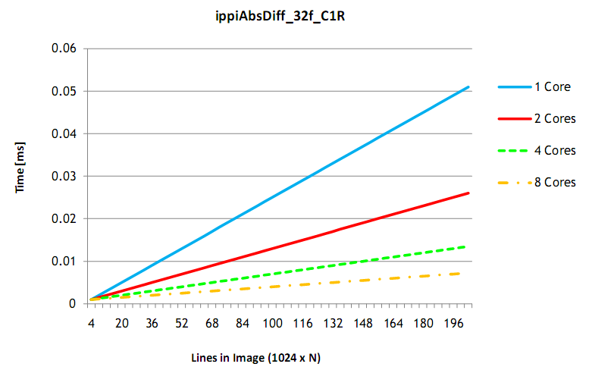
NVIDIA Performance Primitives Tests
Number of cores scalability:
Img src: http://www.nvidia.com/content/GTC/documents/1028_GTC09.pdf
Notes:
Note: rough data, not exact SM count

Slide 25
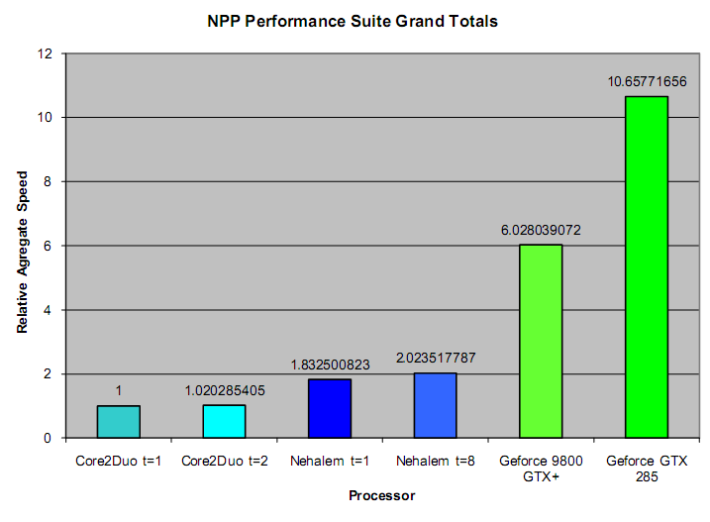
NVIDIA Performance Primitives Tests
Overall vs CPU
Img src: http://www.nvidia.com/content/GTC/documents/1028_GTC09.pdf
Notes:
IPP used for CPU, NPP used for GPU

Slide 26
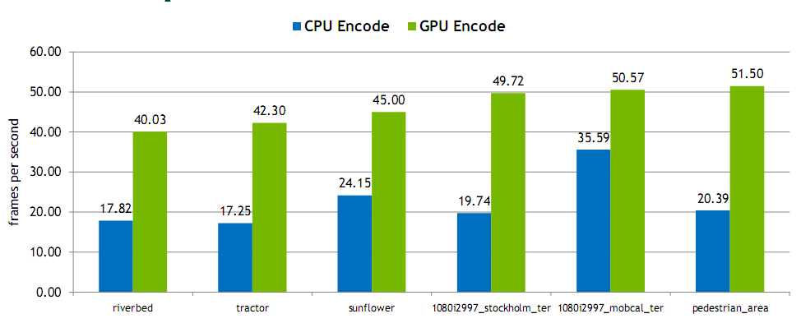
Encoding Performance
Img src: http://www.nvidia.com/content/GTC/documents/1028_GTC09.pdf
Notes:
Frame size: 1080p
Platform: 3.2 GHz quad core Nehalem, GeForce GTX 280 (240 core) GPU
CPU encoder is x264
GPU encoder is NVIDIA H.264 CUDA encoder

Slide 27
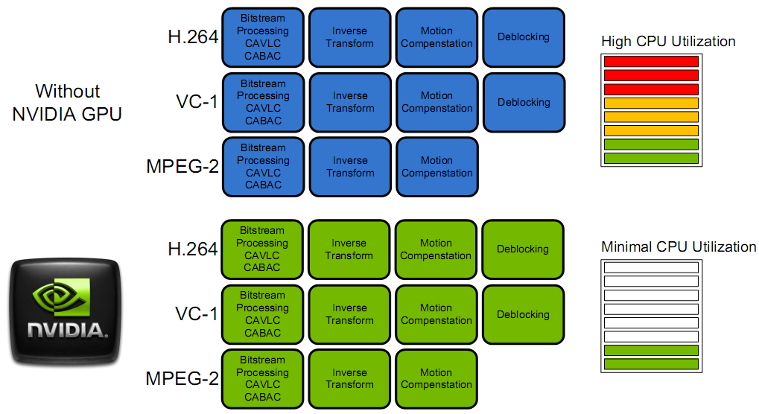
Decoding Performance
Img src: http://www.nvidia.com/content/GTC/documents/1028_GTC09.pdf
Notes:
H.264, VC-1, MPEG-2 = major video codecs

Slide 28
NVIDIA API Demo
See the numbers for yourself!

Slide 29
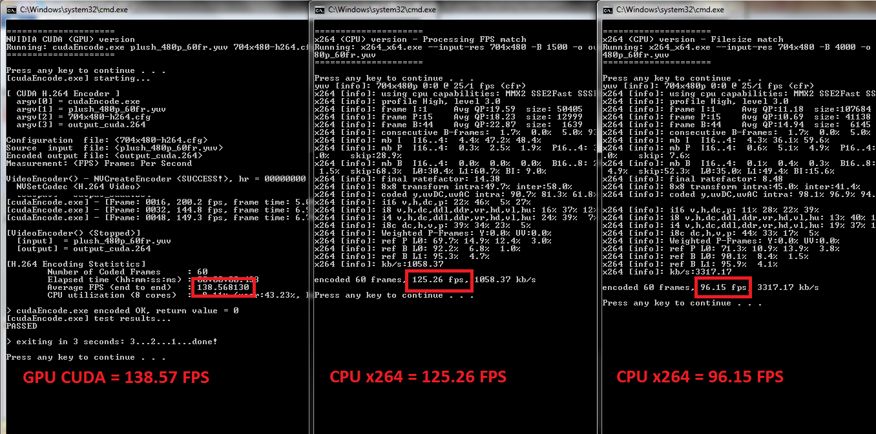
NVIDIA CUDA Video Encode API
http://developer.nvidia.com/cuda-cc-sdk-code-samples#cudaEncode

Slide 30
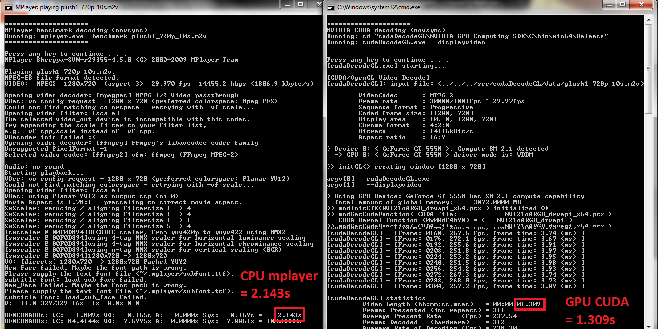
NVIDIA CUDA Video Decoder GL API
http://developer.nvidia.com/cuda-cc-sdk-code-samples#cudaDecodeGL

